Slide 1




Community Advisory Boards in Aging Research
Joseph E. Gaugler, PhD | University of Minnesota

Slide 2
Acknowledgements
Care to Plan
  K02 AG029480 (Gaugler, PI)
  R03 HS020948 (Gaugler, PI)
  K18 HS022445 (Gaugler, PI)
ADS Plus
  R01 AG049692 (Gitlin and Gaugler, PI)
Center for Healthy Aging and Innovation
  Equity and Community Engagement Core (Frazier & Johnson)
BOLD Public Health Center of Excellence on Dementia Caregiving
  NU58DP006910-01-00

Slide 3
Aims
Summarize how community advisory boards (CABs) are employed and their rationale
Review our experiences with CABs from a scientific and infrastructural perspective
Identify tools for best practices
Workshop application of CABs: Small group exercise and reporting out

Slide 4
Background (Anderson et al., 2020)
Translational research is “the multidirectional integration of basic research, patient-oriented research, and population-based research, with the long-term aim of improving the health of the public” (McGartland Rubio et al., 2010, p. 4).
Community engagement can be/is key to the translational
Community advisory boards (CABs) can facilitate the translational process (Minkler, Salvatore, & Chang, 2018)
  Extensive variability in application

Slide 5
Community Engagement
“Community engagement is the process of working collaboratively with and through groups of people affiliated by geographic proximity, special interest, or similar situations to address issues affecting the well-being of those people. It is a powerful vehicle for bringing about environmental and behavioral changes that will improve the health of the community and its members. It often involves partnerships and coalitions that help mobilize resources and influence systems, change relationships among partners, and serve as catalysts for changing policies, programs, and practices (CDC, 1997/2011, p. 9)”.

Slide 6
Community Engagement→CABs (Anderson et al.,2020)
80% of institutions with Clinical and Translational Science Awards aspire to community engagement via CABs (Eder et al., 2018).
CABs are often defined as a formal group of individuals often drawn from the community, healthcare sectors, the government, or research to provide input, guidance, and sometimes approval of various aspects of research
Although in fully actualized community-based participatory research (CBPR) designs CABs are empowered to engage and, in some instances, co-create/direct every stage of the research process (question, proposal, funding, data collection, recruitment/enrollment, data interpretation and inferences, dissemination, implementation/adaptation), most often CABs’ roles in research are more limited

Slide 7
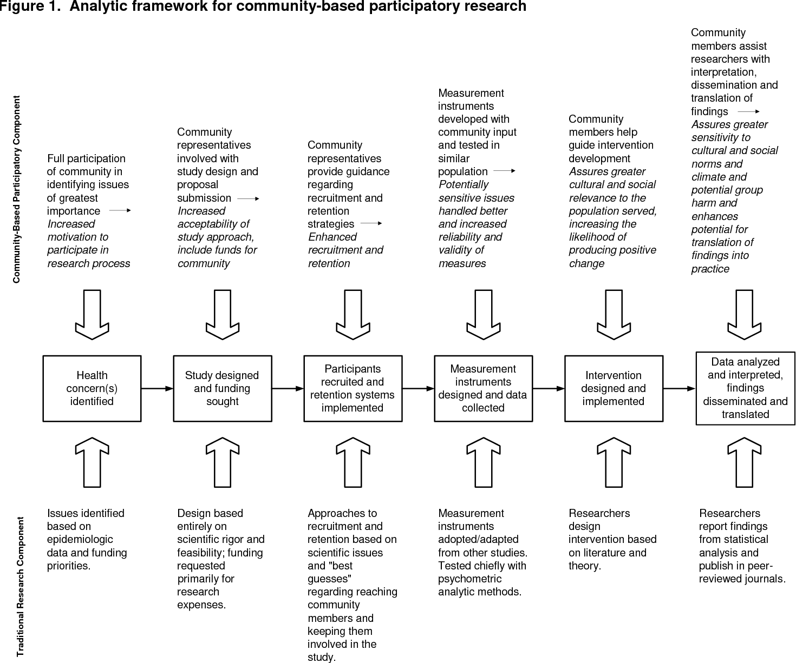
From Viswanathan et al., 2004

Slide 8
CAB Continuum (Anderson et al., 2020)
From consultation to shared leadership (Carman et al., 2013)
A range of roles and responsibilities:
  Participating in meetings
  Serving as liaisons to the community
  Consultation/advice
  Recruitment
  Dissemination

Slide 9
CAB Challenges and How to Address Them (Anderson et al., 2020)
Challenges (Grunbaum, 2011)
  Overcoming the cultural divide between academia and community
  Working with communities that have different cultural priorities, nomenclature, and preferences/needs than the predominant, biomedical science culture
Addressing challenges
  Building and maintaining trust, reciprocity, and respect with CAB members
  Investment of time, on-going communication, sharing and relinquishing control
CABs can and should provide a meaningful “seat at the table” for community members to forge relationships, shape scientific advancement and translation, and create partnerships based on empathy and understanding

Slide 10
Best Practices (Newman et al., 2011)
Formation
  Clarifying purpose, functions, and roles
  Determining membership composition and recruitment strategies
Best Processes: Operation
  Establishing operating procedures
  Establishing operating principles
  Establishing leadership, balancing power, and making decisions
Best Processes: Maintenance
  Evaluating partnership processes
  Sustainability

Slide 11
Other Resources
Arnos, D., Kroll, E., Jaromin, E., Daly, H., & Falkenburger, E. (2021). Tools and Resources for Project-Based Community Advisory Board. Community Voice and Power Sharing Guidebook. The Urban Institute. Available: https://www.urban.org/sites/default/files/publication/104938/tools-and-resources-for-project-based-community-advisory-boards_0.pdf. Accessed August 30, 2023.

Slide 13
Other Resources
University of Minnesota Clinical and Translational Science Institute
  https://ctsi.umn.edu/services/community-engagement/tools-resources
Community Toolbox
  https://ctb.ku.edu/en

Slide 14
Care to Plan
The Care to Plan (CtP) tool is an online resource that provides dementia caregivers with tailored support recommendations and guidance in selecting appropriate support based upon individual needs.
Phase I, initial development, involved gathering a robust base of clinical recommendations based on a series of hypothetical dementia caregiver scenarios.
During Phase II, the CtP prototype was tested for feasibility and usability among 21 dementia caregivers.
In Phase III, a CAB was formed to provide stakeholder perspectives to inform the development and improve the translation potential of CtP.
  The CAB provided in-depth reviews of the tool during and immediately following Phase II prototype testing.
  The CAB’s feedback altered content of the CtP web-pages considerably.
Phase IV involved feasibility and usability testing of the CtP Beta version (n = 9 dementia caregivers).

Slide 15
Care to Plan
The Care to Plan (CtP) tool is an online resource that provides dementia caregivers with tailored support recommendations and guidance in selecting appropriate support based upon individual needs.
Phase I, initial development, involved gathering a robust base of clinical recommendations based on a series of hypothetical dementia caregiver scenarios.
During Phase II, the CtP prototype was tested for feasibility and usability among 21 dementia caregivers.
In Phase III, a CAB was formed to provide stakeholder perspectives to inform the development and improve the translation potential of CtP.
  The CAB provided in-depth reviews of the tool during and immediately following Phase II prototype testing.
  The CAB’s feedback altered content of the CtP web-pages considerably.
Phase IV involved feasibility and usability testing of the CtP Beta version (n = 9 dementia caregivers).

Slide 16
Care to Plan: CAB Analysis (McCarron et al., 2020)
I led CAB meetings in an open dialogue format that allowed members to freely provide feedback.
Meetings were held on the University of Minnesota’s campus and lasted 60–90 minutes.
Seven CAB meetings took place
Each meeting was audio recorded (except for one meeting due to a technological challenge) and a senior author took detailed notes on each meeting. Meeting recordings were transcribed.
Meeting transcripts and notes were organized in NVivo 11 for thematic analysis (Braun & Clarke, 2006)
Two research questions guided the thematic analyses:
  (1) How did the CAB process unfold?
  (2) How did the CAB affect the usability and feasibility of the CtP tool?

Slide 19
Care to Plan: Discussion (McCarron et al., 2020)
The CAB was vital in shaping the language used in CtP, naming the tool, identifying problematic wording and suggesting appropriate alternatives
  This ensured appropriate literacy level of the text
Insight by CAB members also improved the functionality of CtP in terms of:
  Appearance: larger font size, higher-contrast color scheme, and navigation buttons.
  Providing links to relevant resources
  Adding progress indicators.
CAB members also pointed out potential barriers in use
Dissemination
  CAB members volunteered to disseminate CtP throughout their personal, professional, and social media networks.
CAB members also provided recommendations for implementation, evaluation, and sustainability

Slide 20
Adult Day Services Plus (ADS Plus)
Does augmenting adult day services with systematic, evidence-based caregiver support, education and skill building (ADS Plus), enhances wellbeing for persons with dementia and family caregivers?
We compared usual care at 18 adult day services to 16 adult day services providing usual care and ADS Plus on these outcomes:
    Family caregiver depressive symptoms
    Family caregiver overall well-being
    Number of days adult day services are used
    Nursing home placement
  See Gitlin et al., 2019, 2023; Roth et al., 2020

Slide 21
What is the Adult Day Plus Intervention?
Provision of on-going caregiver support to families using adult day services using a protocol tested in previous and ongoing pilot work
Five intervention components:
  Assessment of care needs
  Referral and linkage
  Education about disease, behavioral symptoms, caregiving, resources
  Skills training in problem solving, managing behaviors,
  Taking care of self
Novelty of approach:
  Standard yet tailored to unique needs
  Caregiver-centered - caregivers identify top 3 challenges they want to address
  Program integrated into ADS work follow as much as possible
  Use of indigenous staff to deliver intervention
  Minimal staff training
  Families participate at times convenient to them upon pick up, drop off or another time to minimize burden

Slide 22
Two Primary Study Aims
Evaluate effectiveness of ADS Plus to improve caregiver well-being and reduce depressive symptoms compared to routine ADS use at 6 months
Evaluate long-term maintenance effects of ADS Plus at 12 months on caregiver well-being and depressive symptoms

Slide 23
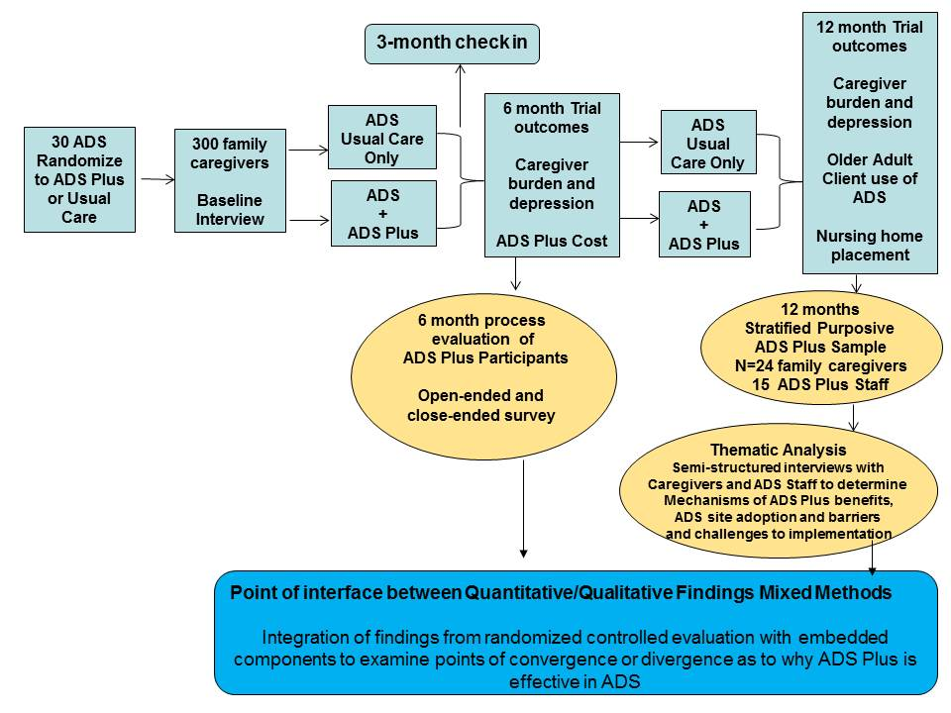
Hybrid Effectiveness Type I Design

Slide 24
ADS Plus Translational Advisory Board (TAB; Anderson et al., 2020)
To foster community engagement and aid in the conduct of the ADS Plus study, we established a Translational Advisory Board (TAB) at the inception of the study and continue to engage the TAB to this day.
The ADS Plus TAB emerged out of preparatory work that began prior to receiving the grant.
The researchers worked with ADS industry leaders and other researchers to ensure that implementation of the intervention was feasible on a large scale.
  Many of these same early collaborators would eventually be invited to serve on the TAB
The TAB included 9 individuals
  Three senior researchers in aging not on the ADS Plus study team
  One ADS policymaker/administrator representing a professional trade group
  Four ADS directors.
The TAB met biannually for approximately one hour via electronic conferencing and the ADS Plus Principal Investigators and Co-Investigators attended and facilitated the meetings (n=7)

Slide 25
Informal Themes (Anderson et al., 2020)
The utility and ability of the TAB to address challenges faced by the study and to aid in developing solutions that the research team could not have envisioned on their own.
  Engaging and activating ADS centers was one of the more challenging problems facing the ADS Plus project team.
  The researchers on the TAB encouraged the ADS Plus team to use a cost-benefit approach to keeping the dormant ADS centers in the study while investing in new ADS centers.
  The practitioners on the TAB reminded the research team that attendance at ADS centers tends to ebb and flow seasonally and that engaging the ADS centers during the holiday season in November and December would be challenging and not productive.
  This led the researcher team to employ new engagement efforts and staging them following the holidays.

Slide 26
Informal Themes (Anderson et al., 2020)
Clear agendas sent at least a week beforehand to TAB members
  Augmenting the agenda with specific questions to stimulate discussions and which were tailored to the group’s expertise was helpful in generating ideas, facilitating discussion, and validating each member’s important role.
TAB composition
  Researchers on the TAB were helpful in understanding ways that they had overcome challenges in their own projects
  Practitioners provided candid “real world” insight into the realities of the challenges faced by an ADS industry with significant financial difficulties.
  Providing questions that are specific to practitioners and soliciting and validating their participation is critically important to capture their vantage point and created a “comfort zone”
Intentionally attending and presenting at meetings where practitioners attend, such as the National Adult Day Services Association and LeadingAge conferences, was rewarding and demonstrated commitment

Slide 27
Lessons Learned (Anderson et al., 2020)
It was vital to actually use the suggestions that the TAB provides and to inform them of the results of employing their suggestions.
Maintaining engagement with practitioners in industries that have significant turnover
COVID-19 impact

Slide 28
Community Advisory Boards as Infrastructure
Center for Healthy Aging and Innovation
  https://www.sph.umn.edu/research/centers/chai/equity-community/community-advisory-board/
BOLD Public Health Center of Excellence on Dementia Caregiving
  https://bolddementiacaregiving.org/leags/

Slide 29
References
Anderson, K. A., Dabelko-Schoeny, H., Koeuth, S., Marx, K., Gitlin, L. N., & Gaugler, J. E. (2021). The use of community advisory boards in pragmatic clinical trials: The case of the adult day services plus project. Home health care services quarterly, 40(1), 16–26. https://doi.org/10.1080/01621424.2020.1816522
Braun, V., & Clarke, V. (2006). Using thematic analysis in psychology. Qualitative Research in Psychology, 3(2), 77–101. https://doi.org/10.1191/1478088706qp063oa
Carman, K. L., Dardess, P., Maurer, M., Sofaer, S., Adams, K., Bechtel, C., & Sweeney, J. (2013). Patient and family engagement: a framework for understanding the elements and developing interventions and policies. Health affairs (Project Hope), 32(2), 223–231. https://doi.org/10.1377/hlthaff.2012.1133
Centers for Disease Control and Prevention (CDC). (1997/2011). Principles of community engagement (1st & 2nd eds.).
Eder, M. M., Evans, E., Funes, M., Hong, H., Reuter, K., Ahmed, S., Calhoun, K., Corbie-Smith, G., Dave, G., DeFino, M., Harwood, E., Kissack, A., Kleinman, L. C., & Wallerstein, N. (2018). Defining and Measuring Community Engagement and Community-Engaged Research: Clinical and Translational Science Institutional Practices. Progress in community health partnerships : research, education, and action, 12(2), 145–156. https://doi.org/10.1353/cpr.2018.0034
Gaugler, J. E., Reese, M., & Tanler, R. (2016). Care to Plan: An Online Tool That Offers Tailored Support to Dementia Caregivers. The Gerontologist, 56(6), 1161–1174. https://doi.org/10.1093/geront/gnv150
Gaugler, J. E., Westra, B. L., & Kane, R. L. (2016). Professional discipline and support recommendations for family caregivers of persons with dementia. International psychogeriatrics, 28(6), 1029–1040. https://doi.org/10.1017/S1041610215002318
Gitlin, L. N., Marx, K., Scerpella, D., Dabelko-Schoeny, H., Anderson, K. A., Huang, J., Pizzi, L., Jutkowitz, E., Roth, D. L., & Gaugler, J. E. (2019). Embedding caregiver support in community-based services for older adults: A multi-site randomized trial to test the Adult Day Service Plus Program (ADS Plus). Contemporary clinical trials, 83, 97–108. https://doi.org/10.1016/j.cct.2019.06.010

Slide 30
References
Gitlin, L. N., Roth, D. L., Marx, K., Parker, L. J., Koeuth, S., Dabelko-Schoeny, H., Anderson, K., & Gaugler, J. E. (2023). Embedding Caregiver Support within Adult Day Services: Outcomes of a Multi-site Trial. The Gerontologist, gnad107. Advance online publication. https://doi.org/10.1093/geront/gnad107
Grunbaum JA (2011). Challenges in improving community engagement in research (pp. 107–148). In, Principles of community engagement (2nd ed.).
McCarron, H. R., Finlay, J. M., Sims, T., Nikzad-Terhune, K., & Gaugler, J. E. (2019). Stakeholder Engagement to Enhance Interventions for Family Caregivers of People with Dementia: A Case Study of Care to Plan. Journal of gerontological social work, 62(1), 29–47. https://doi.org/10.1080/01634372.2018.1505797
Minkler M, Salvatore AL, & Chang C (2018). Participatory approaches for study design and analysis in dissemination and implementation research In Brownson RC, Colditz GA, & Proctor EK (Eds.), Dissemination and implementation research in health: Translating science into practice (2nd e.; pp. 175–190). Oxford University Press.
Newman, S. D., Andrews, J. O., Magwood, G. S., Jenkins, C., Cox, M. J., & Williamson, D. C. (2011). Community advisory boards in community-based participatory research: a synthesis of best processes. Preventing chronic disease, 8(3), A70.
Roth, D. L., Huang, J., Gitlin, L. N., & Gaugler, J. E. (2020). Application of randomization techniques for balancing site covariates in the adult day service plus pragmatic cluster-randomized trial. Contemporary clinical trials communications, 19, 100628. https://doi.org/10.1016/j.conctc.2020.100628
Rubio, D. M., Schoenbaum, E. E., Lee, L. S., Schteingart, D. E., Marantz, P. R., Anderson, K. E., Platt, L. D., Baez, A., & Esposito, K. (2010). Defining translational research: implications for training. Academic medicine : journal of the Association of American Medical Colleges, 85(3), 470–475. https://doi.org/10.1097/ACM.0b013e3181ccd618
Viswanathan M, Ammerman A, Eng E, Gartlehner G, Lohr KN, Griffith D, Rhodes S, Samuel-Hodge C, Maty S, Lux, L, Webb L, Sutton SF, Swinson T, Jackman A, Whitener L. Community-Based Participatory Research: Assessing the Evidence. Evidence Report/Technology Assessment No. 99 (Prepared by RTI—University of North Carolina Evidence-based Practice Center under Contract No. 290-02-0016). AHRQ Publication 04-E022-2. Rockville, MD: Agency for Healthcare Research and Quality. July 2004.

Slide 31
Questions?
Joe Gaugler, PhD
Email: gaug0015@umn.edu
LinkedIn: www.linkedin.com/in/jegaugler
X/Twitter: @umnchai

