Slide 1
Sensor-Assessed Clinic versus Home Gait Measures in At-Fall Risk Older Adults Neil B Alexander^{1,2}, Lauro Ojeda³, Xun Huan³ ¹Division of Geriatric and Palliative Medicine, Department of Internal Medicine, University of Michigan, Ann Arbor, MI ²VA Ann Arbor Health Care System Geriatrics Research Education and Clinical Center, Ann Arbor, MI; ³Department of Mechanical Engineering, University of Michigan, Ann Arbor, MI

Slide 2
Background
Gait in the real world may be slower, asymmetric, and more variable than gait in the clinic due to environmental or other factors not encountered in optimal clinic evaluations.
Real-world gait characteristics may be more directly relevant for understanding a person’s mobility impairment and fall risk.
Many real world gait assessments utilize lumbar mounted wearables, but are limited to temporal gait measurements or make anatomical approximations to derive rough spatio-temporal gait parameters
Inertial Measurement Unit (IMU)-based foot tracking, i.e. Gait Tracking Device (GTD), provides research-grade measurements of foot kinematics, by adapting motion capture system validated methodology.*
*Ojeda J Navigation 2007; Rebula Gait Posture 2013

Slide 3
Specific Aims
The overarching goal of the proposed NIMLAS pilot is to
Compare in-clinic versus home gait measures using this single IMU collection and analytic approach;
Validate any differences that might relate to balance impairment; and
Explore these relationships during real world daily activity in an at-fall risk older adult cohort with varying balance impairment.

Slide 4
Specific Aims
In older adults (n=20) at risk for falls and with varying standing balance impairment, we aim to:
Aim 1: Compare at-home versus in-clinic (Mobility Research Center) differences in key gait measures during a two-minute walk (2MW) test.
Hypothesis 1: The majority of 2MW gait measures will differ, particularly those related to speed, with slowing at-home versus in-clinic.
Aim 2: During the 2MW, determine how different underlying levels of balance impairment affect in-clinic versus at-home gait measures.
Hypothesis 2: At-home (versus in-clinic) slowing will be disproportionately greater in those with greater balance impairment.
Aim 3: Use machine learning methods to analyze variability in gait measures over a three day measurement period to predict levels of balance impairment.
Hypothesis 3: An ML model using gait measures can be trained to predict balance impairment with high accuracy.

Slide 5
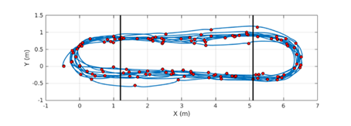
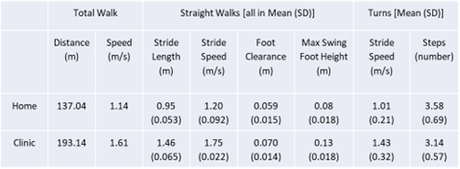
Methods and Preliminary Results
GTD placed on the shoe using a clip and is immediately ready to stream foot kinematics without any anatomical or sensor calibration.
GTD is controlled by a smartphone application that allows direct electronic transmission of foot kinematics using internet/cloud services.
Gait metrics include pace, time, and variability
Figure. Single participant foot trajectory during 2MW. Vertical lines separate straight and turning sections. Red dots=Stance
Table. The home assessment was influenced by self-reported knee pain, likely contributing to slowed gait with reduced stride length and maximum swing step height.

Slide 6
Impact
This project advances the NIMLAS research theme of new technologies to capture measures relevant to aging, using wearable devices and smartphone links.
It has the potential to advance real world gait assessments, in more relevant milieu that better reflect real world task demand and fall risk.
Data may be eventually imported into the electronic health record as powerful measures of health and function.
As the foundation for future extramural funding, the novel kinematic measures proposed may provide better insight into the mechanisms underlying, and better predictors of, real world abnormal gait, losses of balance and falls.
Future larger population studies can link these real world measures with fall occurrence and other key gait- and fall-relevant outcomes such as disability, institutionalization, and mortality.

