Slide 1
Asking people to give us more data: Data linkage and extra-survey tasks
Jonathan Burton, ISER, University of Essex and many many others
Notes:
Hello. Thanks for inviting me to give this presentation. I just wanted to say that I’m sorry that I couldn’t be there in person, which had been my original intention. But I hope to be able to come over and visit Michigan later this year.

Slide 2
Background: Part of the NIMLAS programme
Network for Innovative Methods in Longitudinal Aging Studies
Sub-group on “Maximizing Rates of Consent to Record Linkage and Additional Data Collection”
https://nimlas.isr.umich.edu/research-areas/consent-to-additional-data-collection/
Aim of this presentation is to complement the forthcoming white paper on best practice in this area
Notes:
There is a white paper being developed by a sub-committee of the working group which reviews the best practice in this area.
I’ve not seen that so rather than duplicating it, this presentation will complement it, by picking up strands of research that I’ve been involved in, and how we’re trying to think of this problem more systematically.

Slide 3
Why are we asking people for more information?
Powerful computers make it easier to collect, store, manage, and analyse large datasets
Widespread use of internet and smartphones has opened up opportunities to collect new types of data
We just have to persuade people to let us have these data!
Notes:
So, WHY are we asking people for more information?
Computers mean that it is easier to store, manage and analyse large amounts of data. The widespread use of internet and smartphones means that we are generating more data, and this data is stored digitally – rather than on paper records. So we have greater opportunity to collect and analyse data.
We just have to persuade people to let us have these data!

Slide 4
Data collection technologies have changed…
In the beginning…
< mandatory picture of Literary Digest here>
Notes:
We want to ask people to do more for us. Data collection technologies have changed greatly over the years.
To take a step back….
Here’s where I would be legally obliged to include a picture of the Literary Digest and discuss the Gallup poll. However, I think we all know this. So I’m going to skip 70 years or so and just assume that we know about the growth of surveys, from face-to-face, to mail and telephone, and then to online surveys and the mixing of modes and the growth in power of smartphones.

Slide 5

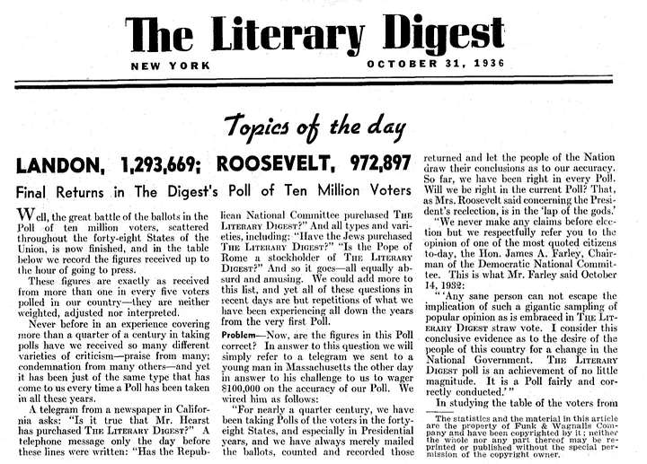
The Literary Digest

Slide 6
Developments in technology lead to new opportunities for data collection
Smartphones
  Sensors, cameras, apps, trackers, microphones…
Notes:
Smartphones have got a lot smarter, with all sorts of sensors built in, plus cameras, microphones, the ability to use apps and trackers…

Slide 7
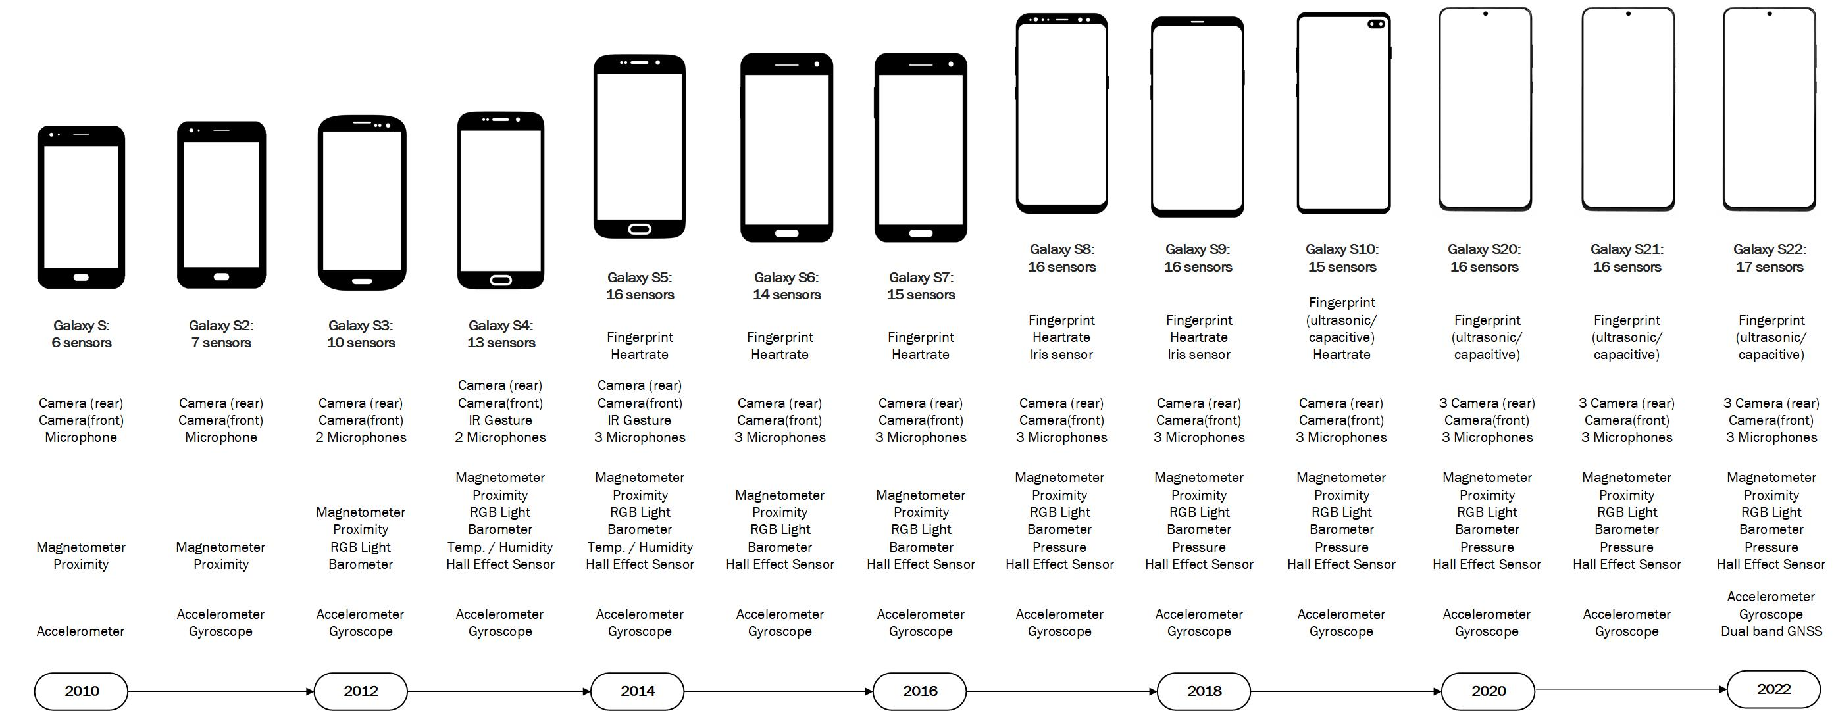
Smartphones are getting smarter
Data Collection with Wearables, Apps, and Sensors, Florian Keusch, Bella Struminskaya, Stephanie Eckman, & Heidi Guyer
Notes:
This is an illustration from Data Collection with Wearables, Apps, and Sensors by Florian, Bella, Stephanie and Heidi.
It shows the increasing sophistication of the Samsung Galaxy series from Galaxy S in 2010, with 6 sensors up to the Galaxy S22 in 2022, with 17 sensors.

Slide 8
Developments in technology lead to new opportunities for data collection - 1
Smartphones
  Sensors, cameras, apps, trackers, microphones…
Wearable sensors
  Accelerometery, air quality, GPS, ….
Digital process-generated data
  Financial transactions, administrative records, social media, ...
Self-collection of biological samples
  Blood, hair, saliva, stool, …
AI…?
Notes:
But not just smartphones, other devices which enable data to be collected in detail are increasing in quality and decreasing in price.
Wearable sensors mean we can collect accelerometry, GPS data, measure sleep quality, air quality and so on.
We’re leaving a larger digital footprint as we go through our every day lives – every time we interact electronically we leave a trace.
Methods to collect biological samples are improving which reduce the cost of collection. And AI…. Anything I would have written when I put these slides together would already be out of date.

Slide 9
Researchers want more types of data
Admin data
Photos
Biological measures
Event-triggered
Sensors
Trackers
Daily questions
Diaries
Gamified apps
Notes:
Because of the growth in new devices and the potential for innovative data collection, researchers have wanted to do more than just ask survey questions

Slide 10
Challenge is getting a representative sample of your population
Stand-alone studies using apps, sensors, trackers…
  Often small-scale
  Using volunteers to test
  Self-selection (e.g., those who already own a specific type of device)
  Lack of context information
  Take place in ideal environment
  Embed the request within a probability sample survey
Notes:
[Slide]
Some of this is the same when looking at linkage to admin data – it only includes the information required for the institution to carry out that specific task, and only includes those who receive the benefit, not those who may need it – for example health records tell you about appointments, diagnoses, medication, and not about those who have not been able to see a doctor.

Slide 11
Piggy-back on the strengths of surveys
Probability samples improve the representativeness of the study
Relatively low barriers to participation
Can collect a wide range of information
…On a large number of people
Able to incorporate requests for additional data collection
Allows researchers to look at selection and measurement effects of participating/consenting
Notes:
Can collect a lot of information about the people taking part, to put the additional data you’re collecting, or linking to, into context. This data can also be used to look at any selection effects – are the people who take part in the additional task or consent to linkage different to those who do not agree.

Slide 12
Data System
Data linkage
Photos
Biological measures
Event-triggered
Sensors
Survey
Trackers
Daily questions
Diaries
Gamified apps
Notes:
So the survey is at the centre of this “data collection system”, used to recruit people for the additional tasks or get permission to link data, and to collect more information about them which researchers need.

Slide 13
Data collection systems
Combining different methods of data collection
  New concepts: information respondents do not know
  Better quality: more accurate (?) information
  More detail than can be asked in questionnaire
  Continuous information over period of time
BUT…Are respondents willing to give consent or to take part in additional data collection tasks?
Notes:
Combining different methods of data collection can lead to data which are able to measure new concepts, in better quality and with more detail that can be asked in a survey. We can collect continuous data passively.

Slide 14

Before I go any further…
www.understandingsociety.ac.uk
Notes:
I need to introduce Understanding Society: The UK Household Longitudinal Study
A lot of the research that I am going to talk about is from Understanding Society – although I will also refer to excellent work done elsewhere.

Slide 15
Last century…
The British Household Panel Survey (BHPS)
Started 1991, funded by the Economic and Social Research Council (ESRC)
Sample of residential households – 5,500 at Wave 1
All residents are ‘original sample members’
Aim: To follow and interview OSMs annually (and anyone they live with)
Design similar to other household panel surveys
Notes:
Some background
ESRC is part of UK Research and Innovation, a non-departmental public body sponsored by the Department for Science, Innovation and Technology.
Indefinite life survey → continue to interview sample members until they are out-of-scope or drop out
Design is similar to other household panel surveys, e.g., PSID (US), SOEP (Germany), HILDA (Australia), SoFIE (New Zealand)

Slide 16

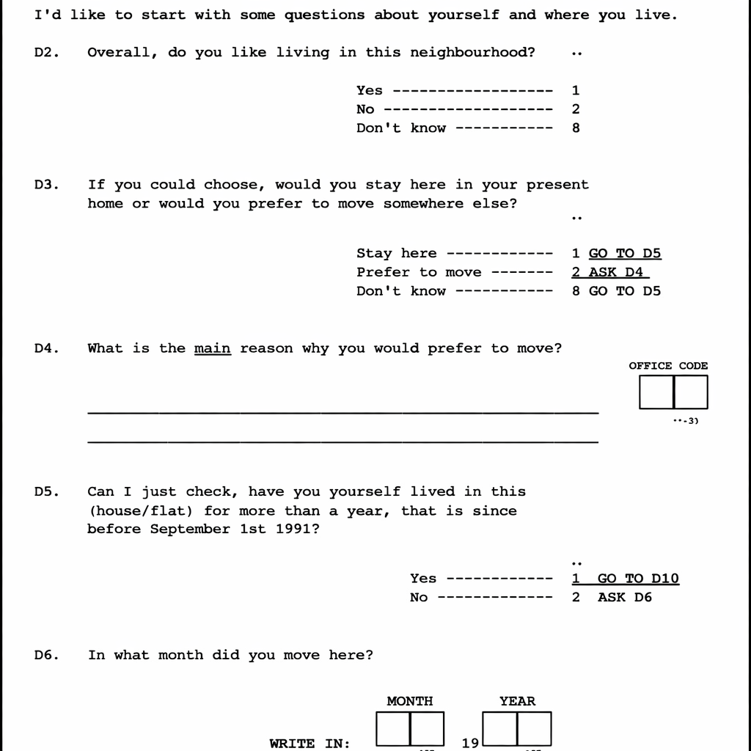
The BHPS
Around 230-250 interviewers
Face-to-face interviews in the homes of respondents
Paper questionnaires – very limited routing, almost no dependent interviewing
Notes:
Dependent interviewing restricted to household membership at the previous wave.

Slide 17
The BHPS - 2
From Wave 9 (1999) – CAPI – allows more complex routing
Primarily face-to-face (1-2% telephone as refusal conversion)
Boost samples in Scotland/Wales (1999) and Northern Ireland (2001)
Ability to use previous-wave information and more complex routing makes it feasible to target key groups of interest in the sample

Slide 18
Understanding Society: The UK Household Longitudinal Study (UKHLS)
Increased interest in key groups → demand for larger sample sizes
2009 – Understanding Society was launched
Funded by the ESRC
Same design as the BHPS…
… but bigger and better!
Notes:
2009 Understanding Society was launched, after a number of years of consultation and feasibility studies.

Slide 19
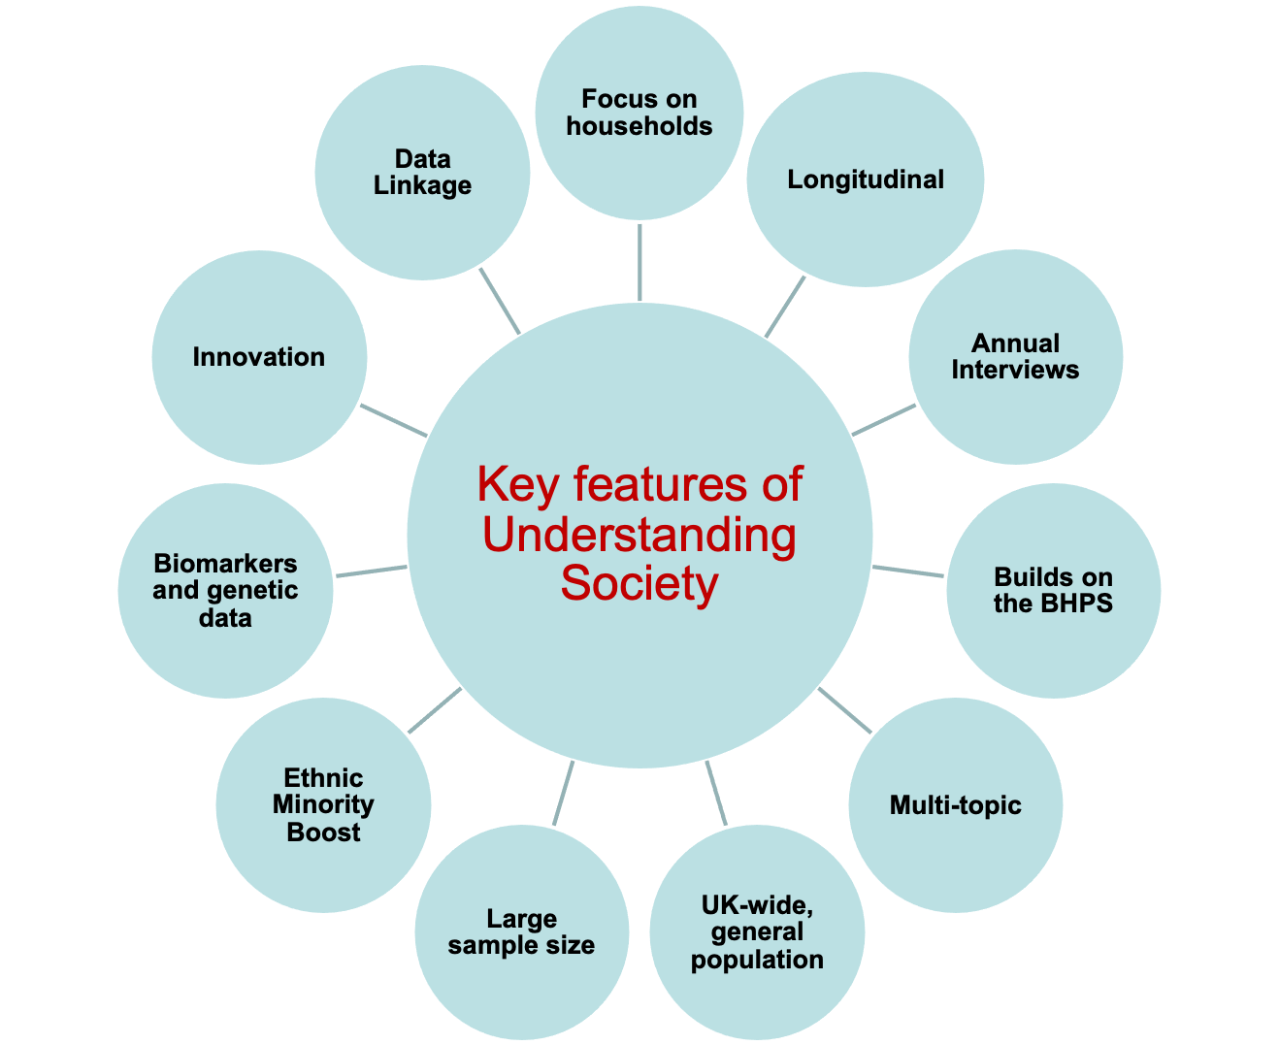
Key Features of Understanding Society
Notes:
Some of the key features are similar to those for the British Household Panel Survey.
There is a focus on households – we want to interview all adults in the households (age 16+) and also ask 10-15 year olds to complete a questionnaire, but we also collect data about other people in the household including babies and younger children.
It is longitudinal – we try to re-contact and interview the same people each year, and it is annual. It’s a multi-topic study, so whilst it doesn’t go into the depth that some surveys go to in particular areas, - so it has less health data than a health survey, and less employment data than a labour force survey, it has a breadth of coverage that allows researchers to look at the impact of health on employment, and vice versa. It covers the whole of the UK general population, including Northern Ireland.
It differs from the BHPS in that the sample size is bigger - 27,000 households, 33,000 adults – which enables research on smaller groups in the population. It includes ethnic minority boosts to enable more robust analysis of different ethnic groups – there was an ethnic minority boost at Wave 1, Wave 6, and we’re currently piloting a third boost for Wave 20 – in 2028.
It has also collected biomarkers and genetic data – with nurse visits after Waves 2 and 3, and then at Wave 16. We have also asked for consent to link to data held be government departments and agencies, as well as social media platforms.

Slide 20
Innovation has always been a central part of Understanding Society
Initial funding from Large Science Facilities Fund included “innovative methods and types of data collection”, and
“‘Innovation Panel’ to trial new methods of data collection”
The Innovation Panel (IP) started one year earlier than the main Understanding Society study
“Enhancements” budget in the current contract to try new things
Notes:
[Slide]
We’ve really benefitted from having funding from the ESRC who have put a high value on innovation and have been willing to fund experiments.

Slide 21
Understanding Society has developed into a mixed-mode study

Slide 22
Over the last ten years: Growth in smartphone ownership and daily internet use
94%
62%
Notes:
There has been growth over this period in smartphone ownership and daily internet usage – but it’s not universal. There are still people who don’t have access to these devices, and a group of people who have access but don’t use the internet regularly.

Slide 23
What have we tried on Understanding Society?
Consent questions
  Link to admin data
  Link to social media data
Notes:
We have implemented a number of request for additional information on Understanding Society. We have asked consent questions

Slide 24
What have we tried on Understanding Society?
Apps
Spending
  Apps with upload pictures of receipts
  Spending diary app
Well-being
  Daily app-based questionnaire
Bio-measures
  Body Volume scanning app
Cognition measures
  “Sea Hero Quest” navigation game (Alzheimer’s Research)
Notes:
We have also implemented a number of app studies.

Slide 25
What have we tried on Understanding Society? 2
Event-triggered data collection
  Monthly “life events”
Bio-marker collection
  Microbiome sample
  Blood sample
  Hair samples
In progress
  Data donation
  Life History calendar
Notes:
And we’ve also asked respondents to do more – by answering short monthly surveys, or providing biological samples.

Slide 26
Experiments on the Innovation Panel to carry out additional tasks
Annual call for proposals for new content and/or experiments
https://www.understandingsociety.ac.uk/innovation-panel-competition/
Either proposed and designed by us
Or proposed by external researchers
  And we negotiate to add methodological experiments
Notes:
A source for these additional data requests is often the Innovation Panel annual call for proposals for new content or experiments.

Slide 27
With new content, we need to think…
What are the research questions?
How do we define the concepts of interest?
What do we want the data to “look like”?
  Unit of analysis
  Granularity
  Regularity
Notes:
When it comes to asking new content, including whether to link administrative data or invite people to a new task, we need to think…

Slide 28
What can we ask respondents to do?
What can respondents do?
What are they willing to do?
How can we make the task as easy as possible?
Balance against burden
Notes:
We need to consider what we can ask respondents to do.
So, what can they do – what is physically or cognitively possible to ask them – and then if we think they can do it, is it something the would be willing to do? We need to think how we can reduce the “friction” between the request and the – hopefully positive – response. For a longitudinal study, we also need to think that if we ask people to do this, and they are able to do it, they are willing to do it, and they do take part – is this likely to affect their willingness to take part in the survey next year?

Slide 29
Can respondents answer question?
Cognitive response process
Do respondents know information?
Easy to recall?
Are they willing to report?
Comprehension
Retrieval
Judgment
Response
Source: Tourangeau, Rips & Rasinski (2000) The Psychology of Survey Response, Cambridge University Press.
Notes:
For survey questions, we consider whether respondents are able to answer the questions. Using the cognitive response process, we consider whether respondents will understand the question, and whether they are likely to know the answer, and be able to retrieve it, will they consider it and respond. This isn’t a linear process as people jump back and forwards through steps.
If the question is too difficult, we may end up with
Recall error
Satisficing
Social desirability bias

Slide 30
Innovation research process (ideally…)
Qualitative research
  What do respondents know about the subject
  What would they be willing to do
  What obstacles might they face
  What would engage them with the task
Invitation to the task
  Experimental groups to test effects on participation rates/bias
Notes:
Qualitative… [Slide]
This is what we aim to do, ideally. However, a lot of the things we’ve experimented with have been opportunistic – where we’ve been asked to carry an experiment or new data collection request, and we’ve added some methodological experimentation.

Slide 31
Innovation research process (ideally…) - 2
Context questions – effect on selection bias
  Socio-demographics of respondents
  Task-related behaviours (e.g., smartphone use)
  Task-related outcomes (e.g., spending, health)
Feedback after invite
  Reasons for/against taking part
  Any problems or issues
Feedback after task
  Ease of participation, obstacles/problems, willingness for future
Notes:
Task-related behaviours – for example, on an app study, information about how much they use a smartphone
Task-related outcomes – something we can measure which is related to the app study – for example, in a spending study, some information about levels of spending.

Slide 32
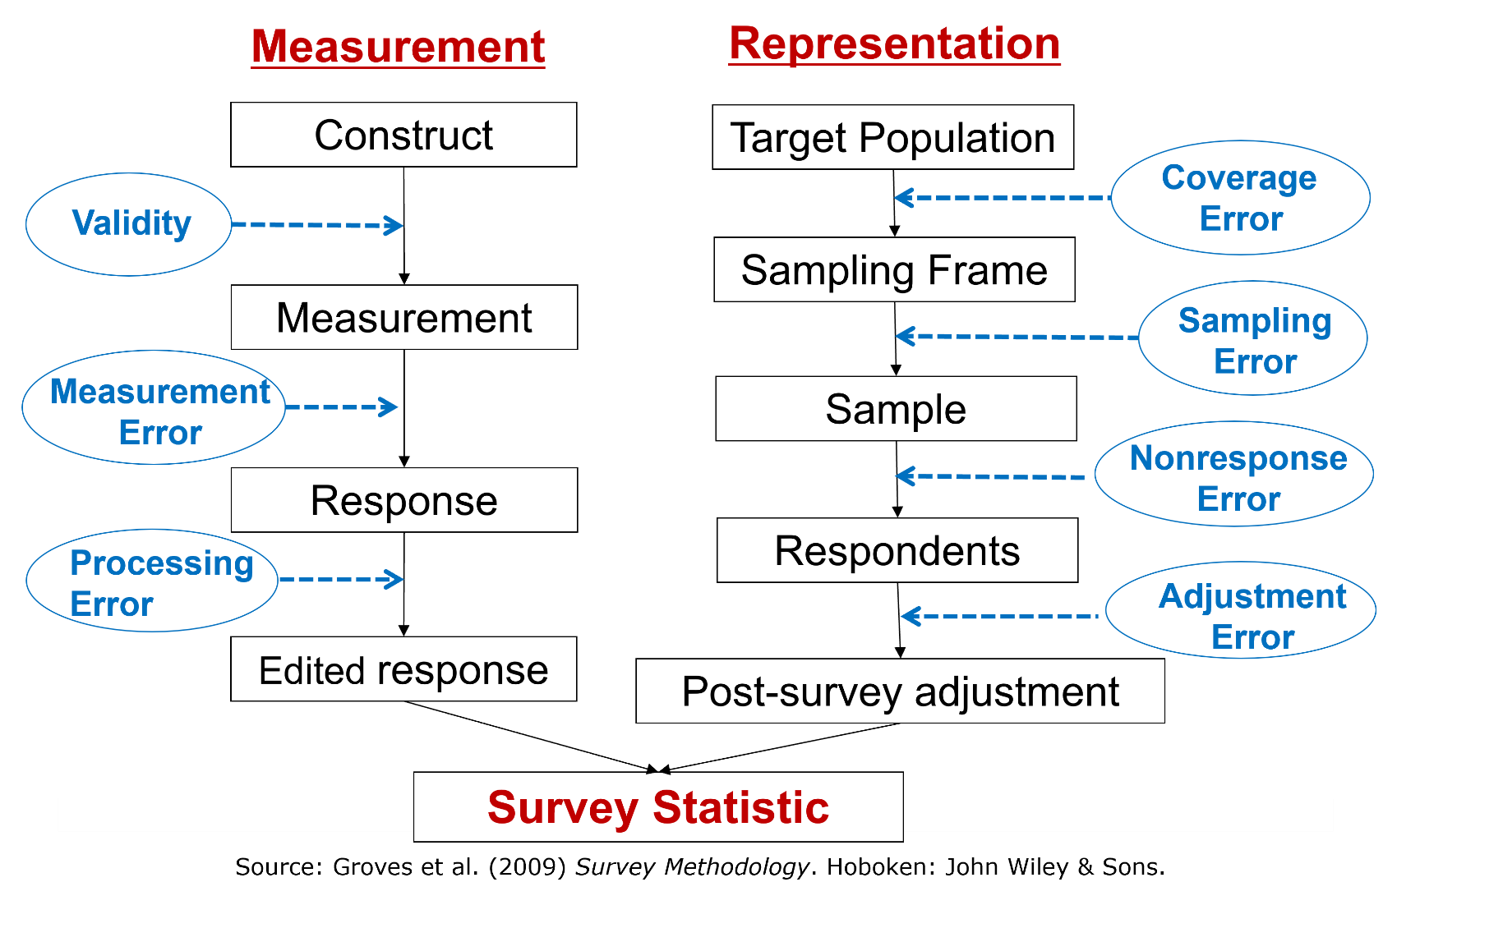
Where can things go wrong?
Total Survey Error framework
Possible errors in selection and measurement
Identify key points where design decisions intervene
Notes:
We try to identify, in advance, key points where we can design the study to reduce the risk of error

Slide 33
Asking people to let us link administrative data to their survey answers
Notes:
Ok, so that’s a bit about the study and how we think about asking people to do additional things. I will be more specific now, and talk about data linkage.

Slide 34
Why link data?
Valuable, rich resource for researchers to link survey data with administrative (or other) data
  (Potential to) reduce respondent burden
  Better quality data (no recall or measurement error)
But admin data lacks context and is collected for other specific purposes, and for specific populations
  Linkage combines depth of administrative data with breadth of survey data
Notes:
This is a version of the slide you always see at the start of any presentation about data linkage…
Administrative data has advantages:
- Includes information that would be difficult or costly to collect via traditional questionnaires.
detailed and often more accurate
But administrative data is collected for a specific reason, to manage an administrative task – it’s not collected with researchers in mind, and might not be completely suitable. It may have very little background information about the individual, and so linkage combines the detail and depth of administrative data, with the breadth of survey data.

Slide 35
Challenges for linking data
Individual-level linking may require agreement – consent – for legal or ethical reasons
Non-consent affects the linked dataset
  Fewer cases
  Potential bias
We want to maximise informed consent
Notes:
Not everyone will give consent, and so non-consent reduces the number of linked cases we have – and if those who do not consent are different in systematic ways to those who do, then there is the potential for bias in the linked data-set.

Slide 36
Legal issues in data linkage
What is the legal basis for linkage?
  UK/Europe – often Public Task/Interest, not “consent”
Is linkage compatible with original purpose?
How are identifiability and minimisation handled?
Do subject have sufficient information on which to made a decision?
Governance and safeguards in place (e.g., DPIAs, ethics, data sharing agreements, etc).
Notes:
What are the legal issues around data linkage? This will affect how you ask for consent, and can restrict what you would ideally want to implement.
This differs across different jurisdictions, and at the end of the presentation it would be interesting to hear about the situation where you work: how the law differs, or how the same law – such as GDPR – is interpreted in different countries.
Consent – often not used as legal basis for data linkage: Consent under the GDPR must be freely given, specific, informed, and unambiguous, and it can be withdrawn at any time. Most of this overlaps with Public Task, but there is a risk that consent needing to be specific may mean that it is granted for a specific research purpose, and if the linked data are required for another research purpose, consent needs to be re-collected.
In addition - where consent is the legal basis, the data subject retains the right to withdraw their consent at any time. If the consent that serves as the legal basis for the data processing is withdrawn, processing generally must stop and the data must be erased. For completed research studies this would be a problem, because altering the underlying database may undermine scientific reproducibility.
[Becker R, Thorogood A, Ordish J, Beauvais MJS. COVID-19 Research: Navigating the European General Data Protection Regulation. J Med Internet Res. 2020 Aug 27;22(8):e19799. doi: 10.2196/19799. PMID: 32784191; PMCID: PMC7470233.]
Is the linkage compatible with the original purpose for which data were collected (purpose limitation and “further processing for research” rules?
How are identifiability and minimisation handled (separation of identifiers, pseudonymisation, safe havens, etc.)
Are data subjects given adequate information and, where applicable, routes to exercise rights (access, objection, erasure, withdrawal of consent)? Privacy Notice?
What governance and safeguards (DPIAs, ethics approvals, contractual controls, technical and organisational measures) are in place for the linkage chain?

Slide 37
Linkage not always require consent
No consent:
  National Statistics Offices often rely on statutory mandate, and public task legal basis
  UK: Office for National Statistics has a legal right to access and link data held by other public bodies – subjects are informed that the data are used for research and statistics
Or implied consent – respondents provided with information before the survey and can withdraw consent to linkage:
  Avon Longitudinal Study of Parents and Children (ALSPAC)
  Family Resources Survey (FRS)
Dennison, 2017; Frances, 2017
Notes:
In the UK, the Office for National Statistics has a legal right under the Digital Economy Act and the Statistics and Registration Service Act to access and link data held by other public bodies for statistical purposes; they rely on public task rather than consent as the GDPR basis, and inform data subjects that data will be used for research and statistics

Slide 38
But ethically…
We believe that it is ethical to ask respondents for their permission to link admin data
Which requires us to provide information at the point of consent
We also provide a Privacy Notice and FAQs online, and carry out a DPIA
We periodically remind people of consents they have given
…But they can withdraw their consent at any time
Heightened awareness of data security and rights with GDPR – if we did not ask consent, risk of backlash against study

Slide 39
Asking consent for data linkage is not quite like other survey questions
With most survey questions, the respondent answers
All the responses are anonymized and analysed together
Saying Yes to consent to linkage has further implications for the respondent
  Their identifiable information is sent somewhere
  Their records are retrieved and linked to their survey responses
  This adds extra effort to the response process
Notes:
[using “consent” even though not using consent…?]

Slide 40


“Understanding and improving data linkage consent in surveys”
Initially a 2-year project funded by the Nuffield Foundation (2018-20)
Continuing research programme as part of Understanding Society
Project page:
https://www.iser.essex.ac.uk/research/projects/understanding-and-improving-data-linkage-consent-in-surveys
Notes:
Understanding Society started asking for consent to data linkage in the first Wave, and regularly – for different domains of data – since. To better understand the process of asking consent, my colleague Annette Jackle led a Nuffield Foundation-funded project into “Understanding and improving data linkage consent in surveys”. The project lasted a couple of years, but has continued as part of Understanding Society.

Slide 41
What we know from previous research
Correlates of consent inconsistent
  Between studies / within studies over time (e.g., Peycheva et al 2021)
  Respondent / interviewer characteristics (e.g., Sala et al 2012, Jäckle et al 2021)
Large variation in consent rates between
  Data to be linked / topics (e.g., Sakshaug et al 2012, Thornby et al., 2018, Edwards and Biddle 2021, Beuthner et al. 2024,
  Interviewers (e.g., Korbmacher & Schröder 2013)
  Modes of interview (Thornby et al 2018)

Slide 42
What we know from previous research 1
Little/limited effect of question wording experiments, e.g.,
  Length of consent question text (e.g., Edwards & Biddle 2021, Singer & Frankel 1982)
  Emphasising benefits to respondent / survey (e.g., Pascale 2011)
  Loss framing – inconsistent results (e.g., Kreuter et al 2016, Sakshaug et al 2019, Beuthner et al. 2024)

Slide 43
What we know from previous research - 2
Many respondents do not understand request (Das & Couper 2014)
Asking earlier in interview (in context) increases consent (e.g. Sakshaug et al 2013, Sala et al 2014, Sakshaug et al 2019, Jäckle et al. 2023)
Half of non-consenters say ‘yes’ if asked again (Weir et al 2014, Mostafa & Wiggins 2018, Jäckle et al. 2018)
Multiple consents in one interview: latent willingness to consent (Jenkins et al 2006; Mostafa 2016)
But only weak latent willingness over time (Mostafa & Wiggins 2018)

Slide 44
What is the problem we wanted to tackle?
Increased interest in data linkage
Increased shift to web-first design
Lower consent rates online!

Slide 45
The problem
% Consent to link to tax records
IP11
IP15
Mode of interview
Mode of interview
-31 pp
-35 pp
Reduces to -22 pp using Intention to Treat
But back up to -30pp when using instrumental variables (local average treatment effect)
Notes:
However, one problem we have is that we get a lower consent to data linkage when asked online, compared to face-to-face – even after controlling for selection effects, the fact that different people might take part online than face-to-face.
WE ALSO FIND (FORTHCOMING) that when non-consenters are re-asked at another wave, whereas about half then consent when asked face-to-face, it’s about a quarter of those when asked online. So we’re less able to pick people up a second time round.
With the increase in mixed-mode surveys, and the large increase in the number of people who complete online, if data linkage is part of the future of data collection, then we need to work out why we’re getting lower consent rates online.

Slide 46
The same in other studies
More evidence on this in a forthcoming Survey Futures publication
Thornby et al., 2018, Peycheva et al, 2023
Ormston et al, 2024

Slide 47
Question: Why are people less likely to consent online?
First - How do people decide whether to consent?

Slide 48
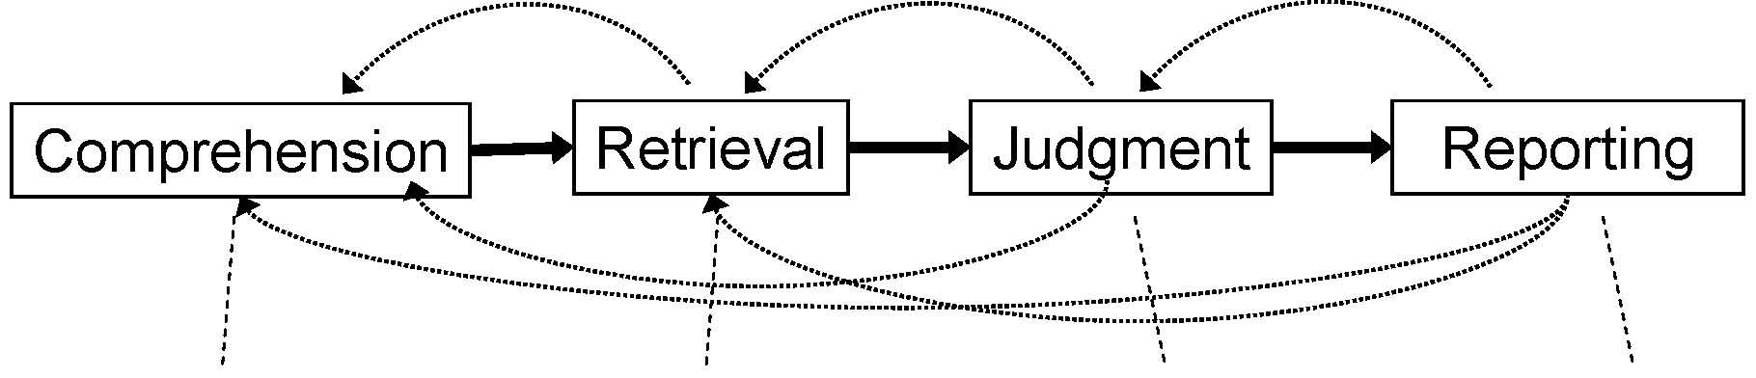
How do respondents decide how to answer a survey question?
Cognitive Aspects of Survey Methodology
Survey response process (Tourangeau et al 2000)
Understanding the meaning of the question and what information it seeks
Recalling relevant information from long-term memory
Combining the retrieved information and filling the gaps
Selecting and communicating an answer
Notes:
This is how we think respondents decide how to answer a “normal” survey question

Slide 49
How do respondents decide how to answer a survey question? Consent
“Optimising” respondents make required effort at each stage
  Costs vs. benefits / consequences of consent
“Satisficing” respondents skip or shortcut stages (Krosnick 1991)
  E.g., Qualitative in-depth interviews on how respondents decide
  Nothing to hide
  Trust in the survey
  What friends/family would say
  Habit, never provide personal information
Notes:
When we ask them a question about agreeing to data linkage, we have “optimising” respondents, who make the effort required at each stage – they weigh up the costs against the benefits, they consider the consequences of agreeing to the consent.
Respondents who are less engaged may ‘satisfice’ – they skip or short cut stages to get to their answer without expending “unnecessary” effort.
From qualitative research we carried out as part of the project, we found that people considered whether they had “something to hide”, their trust in the survey, what people around them would say – or think of them if they agreed/didn’t agree – or just what they usually did out of habit.

Slide 50
Conceptual framework of consent decision
Based on:
Qualitative interviews with IP respondents
  Factors that influence consent decision (Beninger et al 2017)
Cognitive model of survey response process
  How people answer survey questions (Cannell et al 1981, Tourangeau et al 2000)
Survey methods literature
  Consent to data linkage, experiments

Slide 51
Conceptual framework of consent decision - 2
Based on:
Rational vs heuristic decision making
  System 1 vs system 2 processing (Petty and Cacioppo 1986, Kahneman 2011)
Real-life decision making
  People reduce amount of information considered (Galotti 2007)

Slide 52
Conceptual framework
Hypotheses
Respondents necessarily employ heuristics decision processes…
  Limited time and information when responding to a survey
…but heuristic employed varies across person and context
  We label more information-intensive heuristics “reflective”
More reflective decision processes associated with:
  Higher consent rates
  Greater comprehension
  Greater confidence in the decision

Slide 53
Conceptual Framework
Background Characteristics:
Experience
Knowledge
Cognitive capacity
Attitudes
...
Organisations Involved:
Data holder
Survey team
Survey Design:
Content and format request
Context (mode)
…
Markers of Effort:
  Time taken
  View leaflet/diagram
  Self-reported effort
Decision Process
Less reflective
More reflective
Outcomes:
Consent
Comprehension
Confidence in decision
Burton et al (2021)
Notes:
The decision process, about whether to give consent to data linkage, can be more or less reflective – the respondent may decide to put more or less effort into responding. This decision-making process may affect the outcome – whether they give consent – but also affect their understanding of the consent request, and the confidence they have in their decision. We can measure some proxy markers of effort – such as the time taken to make the decision, but also whether or not they took the opportunity to read any additional information provided.
The decision-making process, and the outcomes, are affected by the characteristics of the respondent, including their pre-existing attitudes, but also what the data are, who holds them, who is asking for consent. Then the decision may also be affected by the design of the survey.

Slide 54
To test we need to collect more information
Background questions, e.g.
  Socio-demographics; attitudes to privacy, data security; data sharing
Consent request
Follow-up questions
Paradata: response times, clicks on links, interviewer observations
Audio recordings (CAPI): behaviour coding
Self-reported decision process Subjective understanding of request Objective understanding (test Qs) Confidence in consent decision | Self-reported effort made Factors taken into account Reasons for consenting / or not
Notes:
We need to collect more information than just the answer to the consent question.

Slide 55
Most respondents aren’t giving the question much thought
How did you decide whether to say “yes” or “no” in response to the question about data linkage?
Please select all that apply
I thought about what would happen if I said “yes” or “no” (reflective)
Instinct or gut feeling (gut)
I said what I usually say when I’m asked for information that is very personal (habit)
I thought about how much I trust the organisations involved (trust)
Something else
Only around 1/3 respondents make a reflective decision

Slide 56
Self-reported decision process is corroborated by other indicators
Decisions based on ‘habit’ or ‘gut feeling’ vs. ‘reflective’
  Consent question answered more quickly
  Less likely to click on links to leaflet or diagram explaining linkage
  Lower self-reported effort to answer consent question
  Less likely to say the considered ‘information’ in making their decision
  Less likely to say they considered risks
  Less likely to say they considered benefits
Self-reported decision process measures genuine differences between respondents
Burton et al (2021)
Notes:
It appears that this self-reported decision process is supported by other indicators we have.
For people where the Decision is based on ‘habit’ or ‘gut feeling’ vs. ‘reflective’, we find that…
Consent question answered more quickly (paradata)
Less likely to click on links to leaflet or diagram explaining linkage (paradata)
Lower self-reported effort to answer consent question (scale 0-10)
Less likely to say the considered ‘information’ in making their decision, e.g.: What information the government has about me
Less likely to say they considered ‘risks’, e.g.: How much I trust the organisations involved
Less likely to say they considered ‘benefits’: The benefits to society

Slide 57
How people make the decision relates to consent outcomes
Respondents making habit-based decisions
  Least likely to consent
  Over time: most likely to report same decision process and same consent decision
Notes:
But how people make the decision does relate to the decision to make.
Those who make habit-based decisions are the least likely to consent. Those making reflective or trust-based decisions are more likely to consent.
Over time, as you would expect, those who report making a habit-based decision are more likely to report the same consent decision – and the same process – the next time they’re asked.

Slide 58
Asking early in the interview seems to help
“Can you tell us why you did not give us permission…?”
When consent asked late – significantly more likely to say:
  Too tired to decide
  Unclear about risks involved
  Unclear why, what the data are for
  Too personal, shared enough
Burton et al (2023), Jäckle et al (2022b)

Slide 59

Emphasising trust improves consent online
The next question is about linking the information you provide in this survey, to data that HM Revenue and Customs, or HMRC, hold about you.
HMRC is a trusted data holder
Jäckle et al (2022b)

Slide 60
Results from experimental studies
Ask for consent early in the interview, rather than at the end
‘Giving fatigue’ more likely if ask at the end
Emphasize trust in the organisations involved in the data linkage
Include all key information about the linkage in the consent question
Respondents unlikely to read information leaflets/diagrams
When asking multiple consent questions, start with the one that gets highest consent rate
Simplify readability of consent question wording
e.g. using Flesh-Kinkaid readability score implemented in MS Word
Multiple consent questions can be shown separately or on a single page
Notes:
These are results from our experimental studies about what affects the consent decision.
Readability – e.g., instead of a paragraph of text, bullet-points with the key words at the start of each bullet, so someone skimming can pick-up the salient points.

Slide 61
So what are online respondents doing?
Notes:
That is how we think respondents are thinking about the consent request, but we can see that those who answer online are less likely to consent – so what are they doing?

Slide 62
Conceptual framework
How mode affects the consent decision process
MODE:
Interviewer
vs.
Self-completion
Attitudes / trust
CONSENT:
Rate &
Understanding
Help of interviewer
Cognitive processing
Device used
Social pressure
Jäckle et al. (2022)
Notes:
The mode appears to affect the consent decision. But what are the mechanisms of this process? What is different between the interviewer request and the online self-completion?

Slide 63
Consent and modes study 1
Understanding Society Innovation Panel
Wave 11 (2018)
N=2,608
Consent to link tax record data
Mixed mode data collection
Notes:
Fieldwork conducted by Kantar and NatCen Social Research
More details on the consent wording experiment later

Slide 64
Conceptual framework
How mode affects consent
MODE:
Interviewer
vs.
Self-completion
Attitudes / trust
CONSENT:
Rate &
Understanding
Help of interviewer
Cognitive processing
Device used
Social pressure

Slide 65
1. Potential mechanisms:
Respondent attitudes / trust
Trust is positively associated with consent (Al Baghal 2016; Sakshaug et al 2017; Sala et al 2012)
Trust-based consent decision process: higher consent rates (Burton et al 2021)

Slide 66
1. Potential mechanisms:
Respondent attitudes / trust - 2
Qualitative interviews (Beninger et al 2017):
  "My default is not to... I'd definitely, outside of the Understanding Society, say no but I trust them."
  “I guess I am more likely to consent in person because I don’t know who is asking [questions] online.”
  "They may think online it could go anywhere because we all know once it’s online it is for everyone to see. I think face to face they would feel more comfortable.”

Slide 67
Attitudes about privacy/data security
Asked early in survey, before consent
Privacy concerns
In general, how worried are you about your personal privacy?
Very worried
Somewhat worried
Not very worried
Not worried at all
Data security concerns
Different private and public organizations have personal information about us. How concerned are you about whether or not they keep this information confidential?
Very concerned
Somewhat concerned
Not very concerned
Not concerned at all

Slide 68
Respondents more concerned about privacy when answering online
But… no difference in how much they trust HMRC or belief that the data are sensitive
Jäckle et al (2022a)

Slide 69
Try to “prime” the respondent to think about trust
The next question is about linking the information you provide in this survey, to data that HM Revenue and Customs, or HMRC, hold about you.
HMRC is a trusted data holder
PopulusLive online access panel
Great Britain
Quota to match Innovation Panel
Same questions
‘Easy’ consent question
N=1,921
Experiment
Jäckle et al (2023)
Notes:
Implemented by NatCen Social Research
Follow-up study
Previous results: suggest understanding the consent request is not the main driver of consent
We managed to increase understanding with the easier consent question wording
But that did not increase consent
So here, tried a different approach, which was to prime respondents to think about trust

Slide 70
Mentioning trust increased consent
Relatively large effect
Equivalent to 1/6th of mode gap
Consent rate:
  +5 pp
No effects on
  Understanding
  Objective understanding
  Confidence in decision
  Decision process
Trust is important
Survey design / setting can affect trust
Sub-conscious?
Jäckle et al (2023)
Notes:
Good: low cost intervention; no negative effects on understanding or confidence – we wouldn’t want the trust group to rely on that trust and so ignore all the other information.
But we had expected the trust priming to have an effect on how respondent processes the consent request, factors taken into account in making the decision – but it didn’t and so perhaps the impact of the trust logo was subconscious…?

Slide 71
Conceptual framework – 2
How mode affects consent
MODE:
Interviewer
vs.
Self-completion
Attitudes / trust
CONSENT:
Rate &
Understanding
Help of interviewer
Cognitive processing
Device used
Social pressure
Notes:
It might be the other way round – not that people who answer online are less likely to consent than they would if they were being asked face-to-face, but those who are being asked by interviewers are more likely to say yes that they would if they were answering online, because of factors associated with the interviewer-respondent interaction.
Interviewers: provide explanations, answer questions respondents might have and evoke sense of trustworthiness. Encouragement.

Slide 72
2. Potential mechanisms:
Interviewer behaviours
Qualitative interviews (Beninger et al 2017) :
  “…if someone is talking to you about it they can … alleviate the concerns that just can't be answered by reading on the screen. You never feel you are quite getting enough information to make an informed decision when you are doing it through a screen".
  "If (regular interviewer) had done it face to face she usually gives extra detail and sometimes she can tell by the blank look on my face. She does tend to go into more detail sometimes."
Notes:
Overall, 85.9% of respondents gave permission and there were no significant differences in permission rates between the experimental consent groups (χ² p>0.05). However not all recordings were returned to the fieldwork agency, some recordings were not audible, and sometimes the consent question was missing in the recording. For reasons unknown to us, more recordings are missing if the consent question was asked late rather than early in the interview (χ² p<0.001). There is however no difference between those asked the easy and the standard consent questions (χ² p>0.05). The analysis of interviewer and respondent behaviours is based on the 780 respondents with codable audio-recordings

Slide 73
2. Potential mechanisms:
Interviewer behaviours - 2
Audio-recordings
  FTF interviews
Coded what interviewers & respondents did
  Consent question
Interviewers – rarely
  Emphasized confidentiality (4% cases)
  Offered additional information (14%)
Respondents – rarely
  Expressed concern/uncertainty (5%)
  Asked questions (16%)
Similar conclusions for CATI/web (Sakshaug et al 2021)
Verbal Interviewer behaviours not driving mode differences
Jäckle et al (2022)
Notes:
Overall, 85.9% of respondents gave permission and there were no significant differences in permission rates between the experimental consent groups (χ² p>0.05). However not all recordings were returned to the fieldwork agency, some recordings were not audible, and sometimes the consent question was missing in the recording. For reasons unknown to us, more recordings are missing if the consent question was asked late rather than early in the interview (χ² p<0.001). There is however no difference between those asked the easy and the standard consent questions (χ² p>0.05). The analysis of interviewer and respondent behaviours is based on the 780 respondents with codable audio-recordings

Slide 74
Conceptual framework - 3
How mode affects consent
MODE:
Interviewer
vs.
Self-completion
Attitudes / trust
CONSENT:
Rate &
Understanding
Help of interviewer
Cognitive processing
Device used
Social pressure
Notes:
Cognitive processing – are people who are answering online processing the request in a different way?

Slide 75
3. Potential mechanisms:
Cognitive processing
Qualitative interviews (Beninger et al 2017) :
  "Because the impact isn't as great is it, if you read something online. It's like, you know, it's like reading an email at work - you might not take that information in. But when you're doing it face to face, and you're sitting there, you know, I'm going to read this, aren't I, because you just asked me to."
Notes:
Face-to-face interviews require greater cognitive processing because the person asking the question is there in front of you.

Slide 76
Simplifying the question leads to increased understanding… but not higher consent
Standard wording
  UKHLS consent question (tax records)
  Reading difficulty: Flesch-Kincaid Grade level = 14.5
Easy wording
  Lower reading difficulty: 8.2
  Shorter sentences, shorter words, no passive sentences
  Results from qualitative interviews
  Text broken up into bullet points
Easy wording
  Increased understanding
  No effect on consent
  No interaction with allocated mode
Increasing understanding did not increase consent
Easier wording did not reduce mode effect on consent
Jäckle et al (2022)
Notes:
So it affected the “informed” part, but not the “consent” part…

Slide 77
Respondents understand the request less when answering online
Completely/mostly understood:
Online vs CASI
Subjective understanding: “How well do you think you understand what would happen with your data…”
Objective understanding (8 true/false statements)
But… no difference in confidence in decision
%
%
Jäckle et al (2022a)
Notes:
So they may have not understood the question, but they were still confident in their decision…
Both significant at p<0.001

Slide 78
3. Potential mechanisms: Cognitive processing
Consent decision process
Decision process
  “How did you decide whether to say “yes” or “no” in response to the question about data linkage?” (Select all)
  I thought about what would happen if I said “yes” or “no” (reflective)
  Instinct or gut feeling (gut)
  I said what I usually say when I’m asked for information that is very personal (habit)
  Something else
Web treatment effect (IV)
Reflective decision: -9 pp
Habit-based decision: +12 pp
Response time: 2.2 x faster
Read/clicked leaflet: -32 pp
Information presented was “too much”: +6 pp
Respondents answer consent Qs less thoroughly when answering online
Jäckle et al (2022)
Notes:
Online respondents understand less, and they answer less thoroughly… they are less likely to take a reflective decision and more likely to make a habit-based decision. They answer more than twice as fast as those interviewed face-to-face, they are less likely to click through to the leaflet, but more likely to say that they were presented with too much information.

Slide 79
Further attempts to encourage reflective decision making
Work in progress!
IP17
Control + Treatments:
  CAPI & Web: question text focus on benefits/risks

Slide 80
Focus on benefits and risks
“Linking the information will give researchers detailed and accurate information, without having to ask you more survey questions. This will not affect the way you deal with the DWP now or in future and the DWP will not be given any information about answers you have given in this study.”

Slide 81
Further attempts to encourage reflective decision making - 2
IP17
Control + Treatments:
  CAPI & Web: question text focus on benefits/risks
  CAPI & Web: focus on importance for research and policy

Slide 82
Focus on benefits for research and policy
“Linking the information will give researchers a fuller picture about who does and who does not claim pensions or benefits, or seek help from the DWP. This will tell us whether there are people who should be getting support but are missing out, and how much of a difference pensions and benefits make for people nowadays.”

Slide 83
Further attempts to encourage reflective decision making - 3
IP17
Control + Treatments:
  CAPI & Web: question text focus on benefits/risks
  CAPI & Web: focus on importance for research and policy
  Web: Ask respondents to think about the request

Slide 84
Asking to think more about the request
We would like you to think about the request for permission to link information held by the DWP to your survey responses.
  What do you think are reasons why you might want to give permission?
  And what do you think are reasons why you might not want to give permission?
Notes:
We gave them the introduction to the consent request, telling them what we would like to do. But before we actually asked the question, we asked them to provide possible reasons for and against consenting.

Slide 85
Further attempts to encourage reflective decision making - 4
IP17
Control + Treatments:
  CAPI & Web: question text focus on benefits/risks
  CAPI & Web: focus on importance for research and policy
  Web: Ask respondents to think about the request
  Web: Ask the 4 knowledge questions before response

Slide 86
Asking the knowledge questions
Before we ask you whether you wish to give consent to linkage with the DWP data or not, we would like to understand whether the explanation we gave you about DWP data linkage was clear or unclear.
Here are a few statements about how the linkage is done. Please specify whether you think each of the statements is true or false.
…
Notes:
Here we again had the introduction to the consent request, but again before actually asking them the consent question, we asked them four objective knowledge questions….

Slide 87
And…?
Work in progress!
CAPI
No significant differences
Those in treatment groups not more likely to:
  Consent
  Use reflective decision process
  Have confidence in their decision
  Put in more effort in answering
  Mostly/completely understand process
Notes:
CAPI – personal benefits/risks, and benefits to research/policy

Slide 88
But online…?
Work in progress!
Almost no significant differences
None for benefits/risks; importance for research & policy; asking knowledge questions
But – asking people to list reasons for/against…
  Significantly less likely to consent (-8.4pp)
  Less likely to understand process
  No effect on reflective decision making

Slide 89

Back to the drawing Board
Notes:
Back to the drawing board on trying to nudge people to consider the question more reflectively. We would definitely be interested in any suggestions that you have for this.

Slide 90
Conceptual framework - 4
How mode affects consent
MODE:
Interviewer
vs.
Self-completion
Attitudes / trust
CONSENT:
Rate &
Understanding
Help of interviewer
Cognitive processing
Device used
Social pressure

Slide 91
4. Potential mechanisms:
Device used to complete web survey
Privacy / data security concerns
  Might be influenced by the devices respondents use to complete the survey
  Especially if using pubic wifi
Smaller screen sizes
  Might make it harder to read and process the consent question

Slide 92
4. Potential mechanisms:
Device used to complete web survey - 2
Devices used by web respondents:
  57% PC, laptop, notebook
  29% tablet
  14% smartphone
Logit models to control for respondent characteristics
No differences in
  Probability of consent
  Objective understanding
  Privacy / data security concerns
  Consent decision process
  Whether clicked leaflet/diagrams
Smartphone users
  Information presented: “Too much”
  Took longer to answer consent Q
Devices not driving mode effects
Jäckle et al (2022)

Slide 93
Conceptual framework - 5
How mode affects consent
MODE:
Interviewer
vs.
Self-completion
Attitudes / trust
CONSENT:
Rate &
Understanding
Help of interviewer
Cognitive processing
Device used
Social pressure

Slide 94
5. Potential mechanisms:
Social pressure
Qualitative interviews (Beninger et al 2017):
  "Doing it online is much easier to say no because usually it is just click a box whereas if someone is talking to you about it they can either be persuasive depending on whether they are supposed to be doing that …".
  "Subtle pressures you get in a face to face…you don't want to let that person down."

Slide 95
Consent and modes study 2
Understanding Society Innovation Panel 15 (2022)
Consent to link tax record data: F2F respondents:
  CAPI: interviewer reads Q and records answer [nudge to deeper cognitive processing, higher social pressure]
  Partial-CASI: interviewers read out Q, respondent records answer in self-completion module [no social pressure]
  CASI: consent Q in self-completion module [no nudge towards deeper processing, no social pressure]
Walzenbach et al (2023)

Slide 96
5. Potential mechanisms:
Social pressure - CAPI
Consent rates:
Consent decision process:
  CAPI more likely to report gut feeling based decision
  (Expected more reflective decisions with CAPI)
Objective knowledge test: n.s.
Reasons for consenting: n.s. (incl. indicators of social pressure)
 | % | n
CAPI | 77 | 213
Partial-CASI | 77 | 198
CASI | 85 | 216
Expected:
Highest rates in CAPI
Notes:
We were expecting to have the higher consent rates in CAPI – where we were trying to nudge respondents to deeper cognitive processing, and where there was higher social pressure. However, the consent rate was the same as the Partial-CASI, where the respondent answered in self-completion mode and so whilst there was a nudge to more cognitive processing, there was no social pressure. Meanwhile, the treatment that we thought might get the lower consent rate, with no deeper cognitive processing and no social pressure – CASI – actually had the highest.

Slide 97
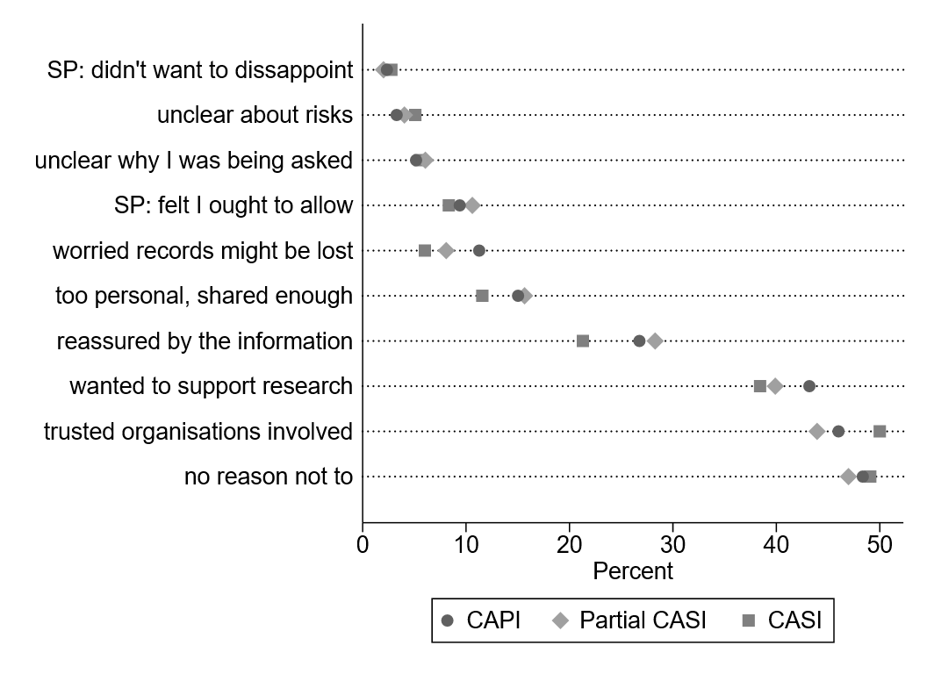
5. Potential mechanisms: Social pressure
“When you were deciding… which of the following applied to you?”
No success manipulating social pressure in FTF
Notes:
No differences between treatment groups significant

Slide 98
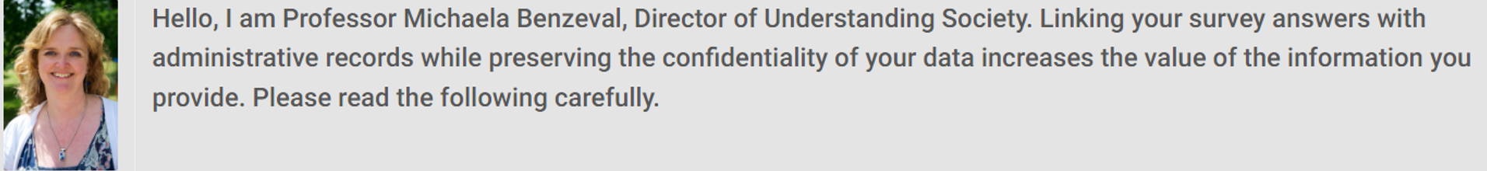
Consent and modes study 2 - Web
Understanding Society Innovation Panel 15 (2022)
Consent to link tax record data: Web respondents:
  Standard question
  Question with message from Study Director
Walzenbach et al (2023)

Slide 99
5. Potential mechanisms:
Social pressure - Web
Significantly higher consent rate
More likely to consider trust when making decision
No effect on objective knowledge

Slide 100
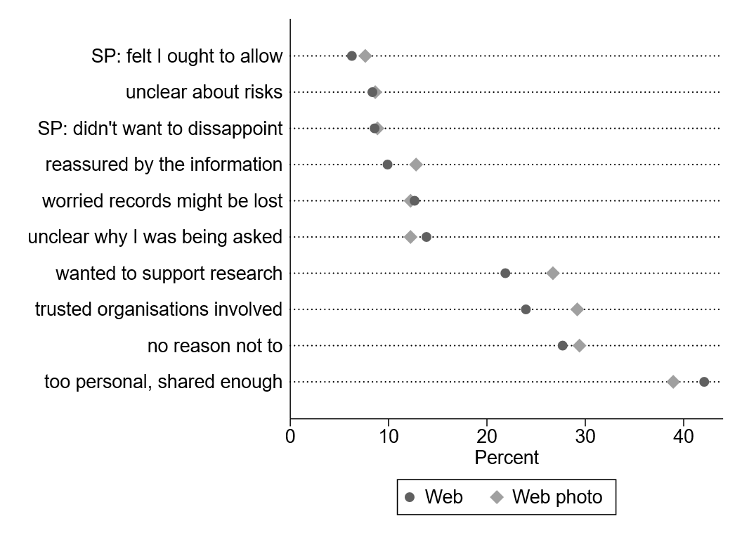
Those who saw the picture more likely to say they consented because of trust or support research

Slide 101
5. Potential mechanisms: Social pressure II
IP18
Experiment with video of interviewer reading question
vs standard
vs “value of science”
Final data due in March
Early data!
Notes:
But we have an early delivery…These are interim figures, and the video treatment group has a significantly higher consent rate compared to other two groups.

Slide 102
5. Potential mechanisms: Social pressure II - 2
Video treatment
More likely to prompt reflective decision process
More likely to think about trust in the organisation
Also higher reported cognitive effort
Early data!
Notes:
Cognitive effort on a 0-10 scale of 4.1 for video and 3.7 for standard.

Slide 103
Summary of how mode may affect consent
Respondents use different decision processes
Only a minority use a reflective decision process
Reflective decision process associated with consent and comprehension
  Limitation: causality not established

Slide 104
Respondents answer less thoroughly when answering online
Less likely to make a reflective decision (-9pp)
More likely to make a habit-based decision (+12pp)
Respond faster (2.2x)
Less likely to read information leaflet (-32pp)
More likely to feel information given was “too much” (+6pp)
Jäckle et al (2022a)

Slide 105
It doesn’t appear to be…
Devices
  No differences in consent, understanding, privacy/security concerns, decision processes, accessing information
(audible) Interviewer-interaction behaviours
  Rarely emphasise confidentiality (4% cases) or offer additional information (14%)
  Respondents rarely express concern (5%) or ask questions (16%)
Jäckle et al (2022a)
Notes:
Devices used by web respondents: 57% PC, laptop, notebook; 29% tablet; 14% smartphone
Logit models to control for respondent characteristics
Overall, 85.9% of respondents gave permission and there were no significant differences in permission rates between the experimental consent groups (χ² p>0.05). However not all recordings were returned to the fieldwork agency, some recordings were not audible, and sometimes the consent question was missing in the recording. For reasons unknown to us, more recordings are missing if the consent question was asked late rather than early in the interview (χ² p<0.001). There is however no difference between those asked the easy and the standard consent questions (χ² p>0.05). The analysis of interviewer and respondent behaviours is based on the 780 respondents with codable audio-recordings

Slide 106
Will making the question easier help understanding?
Yes
  “Easy” wording, increases objective understanding (4.5 → 5 correct)
  Higher objective understanding associated with higher consent (not causal)
But…
  Easy wording did not reduce the mode effect
  Interview mode affected consent, regardless of wording
Jäckle et al (2022a, 2022b)

Slide 107
What helps?
  Asking early in the interview
  Priming with trust
  Introducing ‘social pressure’ online
  Making the question wording easier
  Providing additional information

Slide 108
Moving to more active participation

Slide 109
Moving to more ‘active’ decisions…
Consent to data linkage is passive
  The respondent says Yes/No
  They don’t have to anything else
  If they agree, additional tasks happen elsewhere by other people
Other examples of additional tasks require the respondent to actively do something

Slide 110
Conceptual Framework for consents
Background Characteristics:
Experience
Knowledge
Cognitive capacity
Attitudes
...
Organisations Involved:
Data holder
Survey team
Survey Design:
Content and format request
Context (mode)
…..
Markers of Effort:
  Time taken
  View leaflet/diagram
  Self-reported effort
Decision Process
Less reflective
More reflective
Outcomes:
Consent
Comprehension
Confidence in decision
Burton et al (2021)
Notes:
This is the conceptual framework for consents

Slide 111
Conceptual Framework for additional tasks
Ability
Necessary kit
Technical capability
Background Characteristics
Organisations Involved
Survey Design
Additional task request:
What are we asking?
How are we asking?
What are we offering?
Markers of Effort:
  Time taken
  View leaflet/diagram
  Self-reported effort
Decision Process
Less reflective
More reflective
Outcomes:
Participation
Compliance
Comprehension
Confidence in decision
Modified from Burton et al (2021)
Notes:
Here the conceptual framework also includes the additional task request. This impacts on the outcome directly, but also affects the decision process. The outcomes are both participation – agreement to take part in the additional task – but also compliance, whether they go through and fully participate.
It also includes another stage – once the decision has been made to take part in the additional task – there is the ability to carry that out. Participants need to be willing and able. They need to have the right equipment – for example a smartphone which is sufficiently new and updated, with enough storage capacity, a good enough camera and so on – and they need to be know how to use it.

Slide 112
Additional Task Requests…
What are we asking the respondent to do?
  Time
  Effort
  Discomfort
  Risk of disclosure
  Intrusion of privacy
What are we offering?
  Incentive
  Feedback
  “benefits to science”, altruism
How are we asking?
  Wording
  Placement
  Additional information
  Mode
  Timing
  …
Notes:
Following slides: examples….

Slide 113
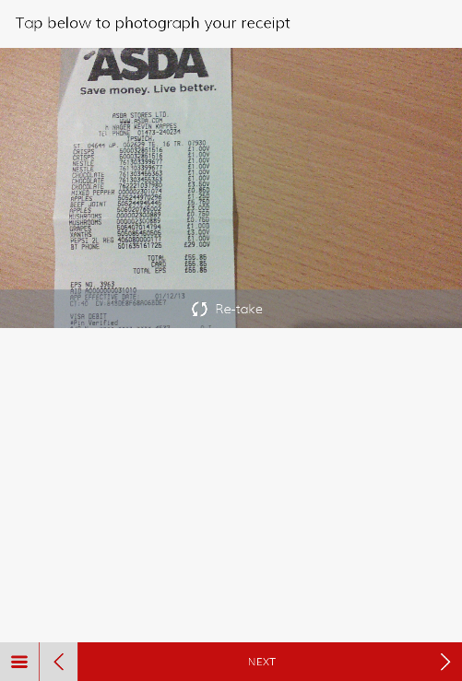
Understanding Society: App studies…
2016 – Spending Study 1
  Ask people to upload photos of receipts for 1 month
2018 – Spending Study 2
  Daily spending diary for 1 month
2020 – Well-being study
  Daily (evening) app-based survey for 14 days
2022 – Body Volume app
  Ask people to use an app to take two scans of their body
2023 – “Sea Hero Quest” app
  Navigation game to measure spatial cognition

Slide 114
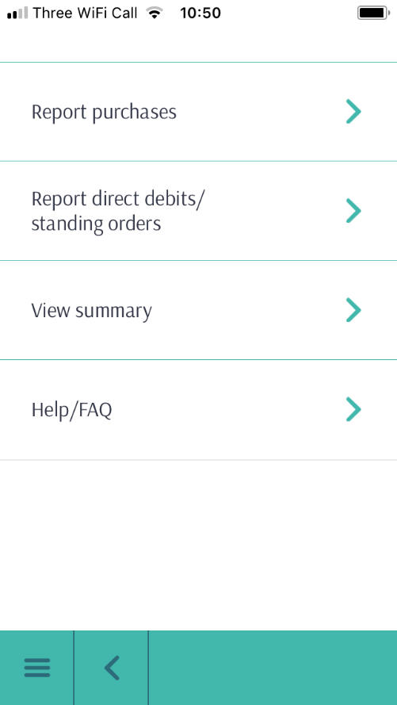
Understanding Society: App studies… 2
2016 – Spending Study 1
  Ask people to upload photos of receipts for 1 month
2018 – Spending Study 2
  Daily spending diary for 1 month
2020 – Well-being study
  Daily (evening) app-based survey for 14 days
2022 – Body Volume app
  Ask people to use an app to take two scans of their body
2023 – “Sea Hero Quest” app
  Navigation game to measure spatial cognition

Slide 115
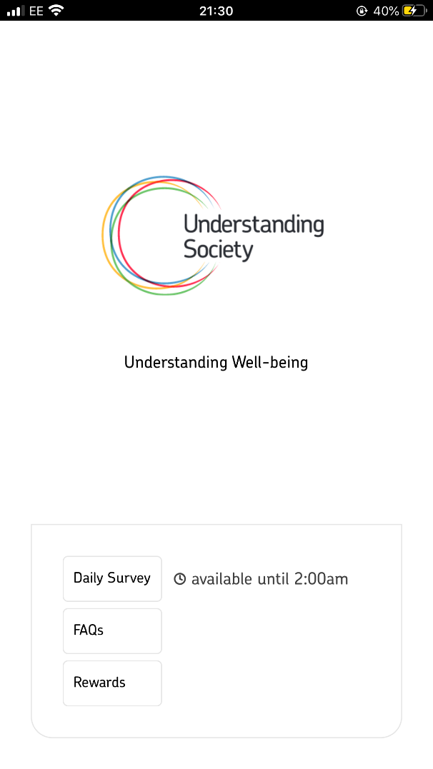
Understanding Society: App studies… 3
2016 – Spending Study 1
  Ask people to upload photos of receipts for 1 month
2018 – Spending Study 2
  Daily spending diary for 1 month
2020 – Well-being study
  Daily (evening) app-based survey for 14 days
2022 – Body Volume app
  Ask people to use an app to take two scans of their body
2023 – “Sea Hero Quest” app
  Navigation game to measure spatial cognition

Slide 116
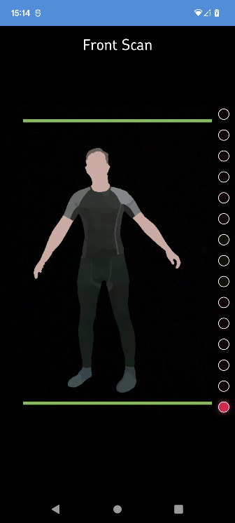
Understanding Society: App studies… 4
2016 – Spending Study 1
  Ask people to upload photos of receipts for 1 month
2018 – Spending Study 2
  Daily spending diary for 1 month
2020 – Well-being study
  Daily (evening) app-based survey for 14 days
2022 – Body Volume app
  Ask people to use an app to take two scans of their body
2023 – “Sea Hero Quest” app
  Navigation game to measure spatial cognition

Slide 117
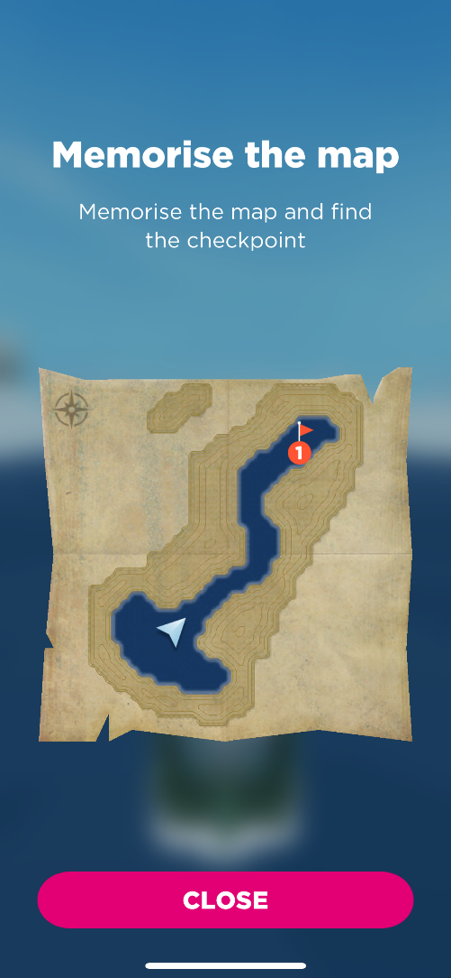

Understanding Society: App studies… - 5
2016 – Spending Study 1
  Ask people to upload photos of receipts for 1 month
2018 – Spending Study 2
  Daily spending diary for 1 month
2020 – Well-being study
  Daily (evening) app-based survey for 14 days
2022 – Body Volume app
  Ask people to use an app to take two scans of their body
2023 – “Sea Hero Quest” app
  Navigation game to measure spatial cognition

Slide 118
Innovation Panel respondents
%
% Smartphone users
Navigation Game
Wellbeing
Body Volume
% App Study Participants
Spending
Spending
➔ Topic matters?
Notes:
On the IP we see the same increase in the proportion of sample members who use smartphones. We also see that some app studies are clearly more popular than others.
Smartphone use:
2016: 66%
2023: 92%
SS1: 13%
SS2:17%
Wellbeing: 45%
BVI: 18%
Navigation: 47%

Slide 119
Where do we lose respondents?
Notes:
If we can identify where we lose respondents, we might be able to work out how to *keep* respondents.

Slide 120
The main obstacle to app study participation is willingness, rather than technical reasons
Notes:
We collect information about why people did not take part in the app study, to see where people dropped out. This looks at the Body Volume app, which was one of the less popular, and the Navigation game, which was one of the more popular. We need participants to be willing and able to take part. For the app studies we’ve run more recently, it seems that willingness is the main obstacle, rather than technical reasons. We should note, though, that these two app studies used apps which were not particularly “power-hungry”, more recent apps – or those with more technical complexity – may need newer models of phones with more recent operating systems.

Slide 121
Why do respondents not want to install our apps?

Slide 122
Why not willing to install app?
%
Notes:
We do ask participants to let us know why they didn’t want to take part in the app studies. This is something we’ve done with the consent to data linkage questions as well and have started including them in other projects which include additional data collection.
The obvious outlier here is the body volume app, where more than a third of those who didn’t want to take part said that they were not willing to share this kind of information. This is where we were asking them to take a full body scan/photo of themselves, and so it was clear that this is just something that people did not want to do. For the other apps, the main reasons were that they had no time, or that they just didn’t want to do additional tasks. This second reason suggests that people are happy to do the annual interview, this is what they ‘signed up’ for – but downloading apps was never part of the original deal.

Slide 123
What types of respondents do participate?

Slide 124
App participants are different to the full sample
Compared to the full sample, younger people are over-represented, older people under-represented
Notes:
This is where we compare the age profile in the full sample with the age profile of those who use the app.
Also see some evidence of bias for sex (women more likely) and education (higher educated more likely).

Slide 125
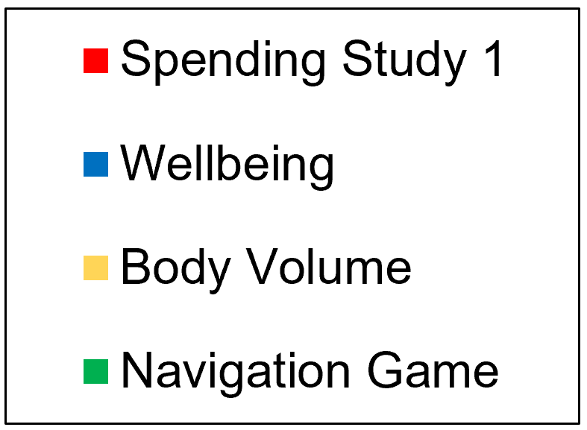
But task-related behaviour is more predictive.
% over-represented

Slide 126
So, what can we do?

Slide 127
Participation in data collection using apps
Invited sample
Device?
Willing & able?
Find app?
Install app?
Log in?
Set permissions?
Use app?
Adhere to protocols?
App data
Jäckle, Burton & Couper (2023) Fiscal Studies.
Notes:
In our context, we start with a sample of survey respondents
And ask them to install and use an app for us
There are multiple steps the respondent has to go through
And of course we lose respondents at every step
- where in this process do we lose respondents?
- and what can we do to reduce these losses and increase participation?

Slide 128
What are the barriers?
Compatible Device | No device, wrong OS, outdated OS

Slide 129
What are the barriers? - 2
Compatible Device | No device, wrong OS, outdated OS
Willing and able to participate | Doesn’t want to, not interested, too busy, privacy concerns, sensitive information, data security concerns, survey asking too much

Slide 130
What are the barriers? - 3
Compatible Device | No device, wrong OS, outdated OS
Willing and able to participate | Doesn’t want to, not interested, too busy, privacy concerns, sensitive information, data security concerns, survey asking too much
Find app | Mis-type app name, does not recognise app, link broken

Slide 131
What are the barriers? - 4
Compatible Device | No device, wrong OS, outdated OS
Willing and able to participate | Doesn’t want to, not interested, too busy, privacy concerns, sensitive information, data security concerns, survey asking too much
Find app | Mis-type app name, does not recognise app, link broken
Install app | Lack of storage space, limited data plan

Slide 132
What are the barriers? - 5
Compatible Device | No device, wrong OS, outdated OS
Willing and able to participate | Doesn’t want to, not interested, too busy, privacy concerns, sensitive information, data security concerns, survey asking too much
Find app | Mis-type app name, does not recognise app, link broken
Install app | Lack of storage space, limited data plan
Log in to app | Typo, log-in not working

Slide 133
What are the barriers? - 6
Compatible Device | No device, wrong OS, outdated OS
Willing and able to participate | Doesn’t want to, not interested, too busy, privacy concerns, sensitive information, data security concerns, survey asking too much
Find app | Mis-type app name, does not recognise app, link broken
Install app | Lack of storage space, limited data plan
Log in to app | Typo, log-in not working
Set relevant permissions | Not willing, misunderstanding why required

Slide 134
What are the barriers? - 7
Compatible Device | No device, wrong OS, outdated OS
Willing and able to participate | Doesn’t want to, not interested, too busy, privacy concerns, sensitive information, data security concerns, survey asking too much
Find app | Mis-type app name, does not recognise app, link broken
Install app | Lack of storage space, limited data plan
Log in to app | Typo, log-in not working
Set relevant permissions | Not willing, misunderstanding why required
Use app once | Not willing, delay before using, forgets

Slide 135
What are the barriers? - 8
Compatible Device | No device, wrong OS, outdated OS
Willing and able to participate | Doesn’t want to, not interested, too busy, privacy concerns, sensitive information, data security concerns, survey asking too much
Find app | Mis-type app name, does not recognise app, link broken
Install app | Lack of storage space, limited data plan
Log in to app | Typo, log-in not working
Set relevant permissions | Not willing, misunderstanding why required
Use app once | Not willing, delay before using, forgets
Adhere to study protocol | Not willing, forgets, weak internet signal

Slide 136
What can we do to reduce barriers?
Device
Loan device
Compatibility: OS / OS version / tablet & phone
Willing & able
Incentives
Find app
Search / link / QR code
Install app
App size
Log in
Set permissions
User name and/or password
Use app
Wording: justification
Adhere to protocols
Reminders
App design & instructions
Bonus incentives
Password usability
Name and logo of app
Length of task (# days / daily time)
Mode of invitation: letter / in interview
Placement of invitation in interview
Wording: purpose / privacy / data security…
Feedback
Incentives
Loan devices?
  Expensive
  Require training materials
  Technical helpline
Check OS in questionnaire
  Requires respondent to know it
  Or instructions on how to find it
Design for lower/older OS
  Loss of functionality for app
Jäckle, Burton & Couper (2023) Fiscal Studies.

Slide 137
What can we do to reduce barriers? - 2
Device
Loan device
Compatibility: OS / OS version / tablet & phone
Willing & able
Incentives
Find app
Search / link / QR code
Install app
App size
Log in
Set permissions
User name and/or password
Use app
Wording: justification
Adhere to protocols
Reminders
App design & instructions
Bonus incentives
Password usability
Name and logo of app
Length of task (# days / daily time)
Mode of invitation: letter / in interview
Placement of invitation in interview
Wording: purpose / privacy / data security…
Feedback
Incentives
How can we increase willingness?
Jäckle, Burton & Couper (2023) Fiscal Studies.

Slide 138

How do respondents decide?
Value for science?
Topic Interest
Invitation wording?
Burden?
Personal benefit?
Intrusive?
Technical requirements?
Risks?
Emotional state?

Slide 139
How can we increase willingness?
Levers?
Incentives
Feedback
Length of task
Question wording
Mode of invite
Placement within interview

Slide 140
Incentives may work if high enough or targeted
Spending study 1
  £2 vs £6 to install app X
Well-being
  £10 bonus for all 14 days vs £2.50 if complete on 4 random days vs no bonus X
Body volume
  £5 conditional on using the app vs extra £5 unconditional for the survey ✓
Sea Hero Quest spatial navigation
  £10 vs £30 for using the app ✓
+7pp
+9pp
Jäckle, Burton & Couper (2023) Fiscal Studies.
Notes:
Body Volume = targeted incentive, at the behaviour we wanted. No significant difference of the extra £5 on the survey response.

Slide 141
Incentives may work if high enough or targeted - 2
Other authors:
Haas et al (2020)
  €20 vs. €10 (IAB-SMART)
Keusch et al (2021)
  €30 vs. €0 (refugees)
McCool et al (2021)
  Bonus if app active 7 days (travel)
  €5 vs. €10 vs. €20
+3pp
n.s.
+10pp
+6pp
Notes:
Body Volume = targeted incentive, at the behaviour we wanted. No significant difference of the extra £5 on the survey response.

Slide 142
Non-financial incentives? Offering personalised feedback?
Spending Study 2
  Feedback on spending in app vs none? X
Body Volume
  Body fat vs visceral fat vs none? X
Rodenburg et al (2023): feedback on Household Budget Survey app – no effect on participation or drop-out
Notes:
If respondents benefit from participating in a study, they might be more willing to participate and motivated to provide complete data. Incentives is one way, but offering personalised feedback may be another.
Similarly, Rodenburg et al. (2023) tested the effects of different feedback conditions in a mobile app-based version of a Household Budget Survey: participants were either offered feedback immediately within the app, or delayed feedback at the end of the study period. The feedback treatments did not affect participation or drop-out from the study

Slide 143
But feedback may work in certain circumstances
Feedback on blood analytes (IP12)
  Offering blood test results increased take-up in CAPI and online
Information that the participant may not know
Notes:
For those allocated to an interviewer, offering feedback increased the willingness to give a blood sample by 10 percentage points (48% v 38%), while on the web, 33% of the feedback group gave blood sample and only 27% of the non-feedback group.

Slide 144
Ask people to spend less time?
Well-being app
  Daily questions on app, open in the evening
  2 minutes or 10 minutes of questions X
Notes:
Time not the biggest barrier?

Slide 145
When and how we ask people may have an effect
Spending Study 2
  Invite in interview ✓
  Invite by letter post-interview
When in the interview?
Well-being app
  Early ✓
  Late
Web: X
CAPI: +20 pp if invited during interview
See also Rodenburg et al (2023); household budget survey.
Interviewer +13pp vs letter
+9pp
Notes:
for web respondents the mode of invitation to the mobile app study made no difference (16 per cent in both groups used the app at least once). For face-to-face respondents, however, the participation rate was 9 per cent among those invited by letter and 29 per cent among those invited in the interview

Slide 146
But mode of interview may not have an effect
CAPI vs Web interviews (controlling for selection)
  Body Volume X
  Sea Hero Quest navigation X

Slide 147
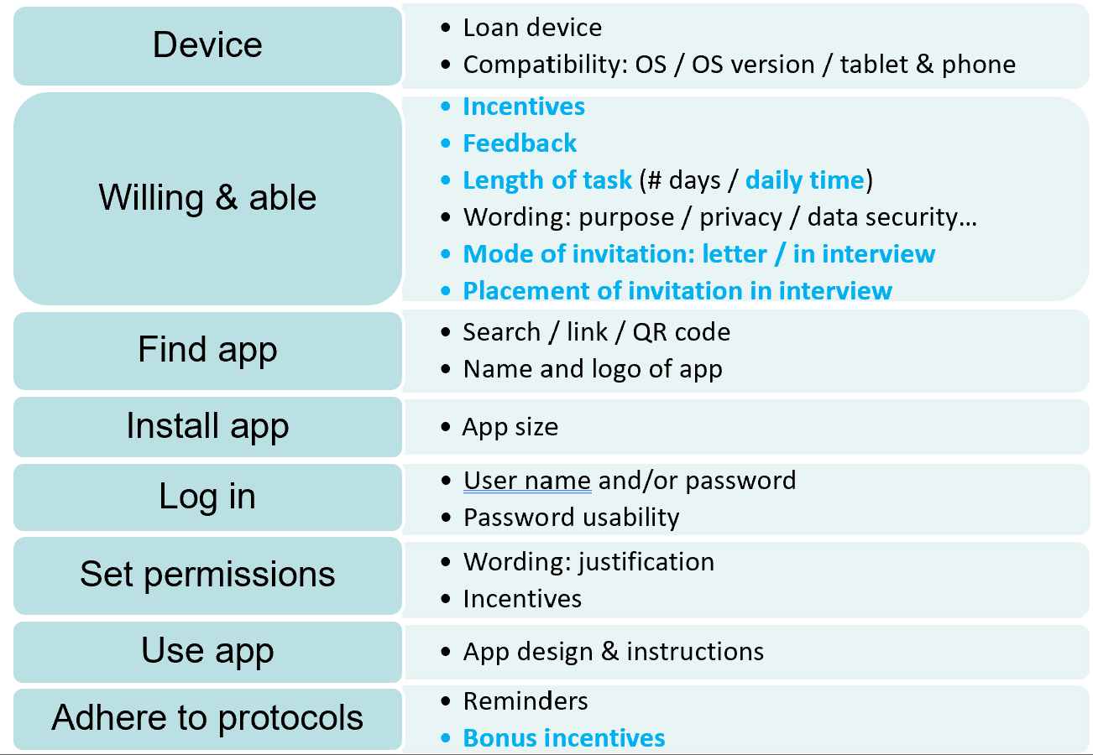
What can we do to reduce barriers? - 3
Jäckle, Burton & Couper (2023) Fiscal Studies.
*UKHLS experiments
Notes:
Ensure name/logo of app unique
Provide direct link in email/SMS
Provide QR code

Slide 148
Summary
Mobile device coverage now high
Few respondents have technical problems (finding, installing, logging in)
Willingness is main problem
Topic of app study matters
Whether respondents already do similar tasks matters
Recruitment in interview / with interviewer more successful
Time required not main barrier
Incentives / feedback do not compensate for other barriers

Slide 149
Additional (non-app) tasks
Event-triggered data collection
Biological measures

Slide 150
Event-triggered data – what we do now
Annual interview
Annual interview
Life now?
Life now?
Recall questions – Annual Events:
Health
Pregnancy
Partnerships
Work
Moves
Difficult to collect retrospectively:
Subjective: expectations, plans, wellbeing
Time-sensitive factual: e.g. during pregnancy
➔ Develop methods to collect data when events occur
https://www.iser.essex.ac.uk/research/projects/event-triggered-data-collection
Notes:
As well as maybe difficult to recall short-lasting events almost a year later, there are data which are difficult to collect retrospectively…
We wanted to develop methods to enable us to collect data closer to the point in time to when they occurred. This means asking people to check-in with us more often.

Slide 151
Event-triggered data collection
Developing protocols
Qualitative research with Innovation Panel sample members
  What willing to do?
  Under what conditions?
Experimental test of Life Event questions
  “Any of these events in last calendar month?”
Monthly Life Events survey
  Every month for 12 months (2020)
Respondent debrief questions
Horsley, A. et al. (2019)

Slide 152
Life Events Study
Monthly filter question
Did you experience any of the following during <last month> 2020?
  Diagnosed with a new health condition or entered hospital/clinic as an in- or outpatient
  Had a pregnancy confirmed / partner had a pregnancy confirmed
  Changed jobs, started or stopped working
  Moved home
  Stopped or started living with a partner
Yes / No
IF No:
End of survey
IF Yes:
Follow-up questions about event(s)
Notes:
The first question in the survey was a filter question, where we asked whether the respondent had experienced any of a list of life events in the previous calendar month
If no, that was the end of the survey for that month
If yes, we asked which events they had experienced and then asked a list of follow-up questions about each event reported
(on average 11% of respondents in each month reported one or more events, 89% reported no events)

Slide 153
Life Events Study
Key findings
No effect of invitation to monthly study on annual interview
  Attrition or reporting of events
Monthly response rates stable
  Increasing from 52% - 57%
Reasons for non-participation
Next steps:
  Questionnaire consultation
  Phase 2 testing (IP) – NOW!
  Roll out on main sample?
Outcome | % | Problem
No internet users in HH | 10 | → Non-coverage
Email and mobile number unknown | 15 | → Non-contact
Non-respondent in all waves | 25 | → Non-response
Completed 1-10 waves | 16 | → Wave non-response / attrition
Completed 11-12 waves | 34

Slide 154
Biological measures

Slide 155
Early in the study (Waves 2 & 3), nurses collected a range of measures
Blood pressure
Height
Weight
Waist measurement
Body fat
Grip strength
Lung function
https://www.understandingsociety.ac.uk/documentation/health-assessment/

Slide 156
Including blood samples
Measures of fat
Indicator of diabetes
Measures of inflammation
Measures of anaemia
Liver & kidney function
Hormones
DNA
  Genotyped data
  Epigenetics
  Proteomics
  Polygenic scores
https://www.understandingsociety.ac.uk/documentation/omics/

Slide 157
Our challenge now is how to collect biomeasures without nurses
Or the use of clinics
And limited use of interviewers (mostly web-first survey)

Slide 158
We experimented using the Innovation Panel (IP12) and the Wave 16 pilot
IP12: Interviewer-led vs participant-led (with nurse visit as comparison)
  Dried blood spots
  Hair
W16 pilot:
  Microbiome
  Blood sample
Tarek Al Baghal, Jonathan Burton, Thomas F Crossley, Michaela Benzeval, Meena Kumari, How Different Mixed-Mode Data Collection Approaches Impact Response Rates and Provision of Biomeasure Samples, Public Opinion Quarterly, 2025, https://doi.org/10.1093/poq/nfaf022

Slide 159
At IP12 (2019) we experimented with interviewer- and participant-led collection
Hair sample and Dried Blood spots
  (Taken by nurse)
  Kit left by interviewer / sent to online consenters
Notes:
But self-measured BP: Web > Nurse > Interviewer – around one-third overall
Actual BP: Nurse > Interviewer (3 readings from 92% vs 77% of respondents)
Height/weight: no difference nurse/interviewer

Slide 160
Higher response to the survey for those issued web-first
Response to the survey
  Highest in web-first
  No difference between interviewer-first or nurse
Response among all issued adults

Slide 161
But, as expected, higher return of samples from those with a nurse visit
Return rate for samples (hair/DBS)
  Highest for nurses
  Interviewer-led higher than participant-led
But offering feedback of results was most effective for web and interviewer modes
Benzeval, M., Andrayas, A., Mazza, J. et al. Does the feedback of blood results in observational studies influence response and consent? A randomised study of the Understanding Society Innovation Panel. BMC Med Res Methodol 23, 134 (2023). https://doi.org/10.1186/s12874-023-01948-y
Notes:
I’ve looked at the

Slide 162
Microbiome – new for Understanding Society (Wave 16 pilot)
Gut microbiome: implicated in depression, anxiety, dementia, obesity and metabolic syndrome.
Evidence suggests that the environment plays a greater role in shaping gut microbiota than genetics
Association of environmental and social factors with the gut microbiota requires further investigation
Experiment in the Wave 16 pilot
  Half the sample allocated to be asked for permission to send a collection kit
Notes:
Microbiome, this is new for us.
Kit sent after interview: DNA Genotek OMNIgene GUT kit with instructions on how to provide a stool sample

Slide 163
However, mentioning microbiome in the advance letter affected response to the survey
Request to send a kit included in the questionnaire
But information about this measure also included in advance materials
Additional testing at IP18 (data due soon)
Notes:
We hadn’t actually asked them to do something else at this stage, we were just telling them that during the interview we would be asking them to do something extra.

Slide 164
Wave 16 pilot: Those interviewed in-person more likely to agree to have a blood kit sent to them
Notes:
Interestingly, looking at the age of the participant, when interviewed face-to-face, those aged under 50 were more likely than those aged 50 or over to consent; whereas online those aged over 50 were more likely to agree.

Slide 165
But less likely to return the blood sample
Social desirability? Say Yes to the interviewer and then ignore the kit when sent? Delay the actual decision?

Slide 166
A couple more examples
Less detail
Areas that we’re looking at now
But other people in this (virtual) room know much more…

Slide 167
Data Donation

Slide 168
Asking for the data rather than collecting it
Alternative to asking respondents to download an app to collect digital trace data
Ask respondent to ‘donate’ their data – often by uploading it to an online portal
  Made easier with European GDPR (and similar) rules on data portability – the right for citizens to get a copy of their data
  Digital platforms provide a Data Download Package (DDP)
  Respondents can review this and upload all or part of the DDP; pre-processing to extract the required data
Notes:
Also - California Consumer Privacy Act has similar rules

Slide 169
Asking for the data rather than collecting it - 2
Examples with Instagram (van Driel et al 2022), Facebook (Kmetty and Németh 2022), smartphone health monitoring apps (Keusch et al 2025); but note differences between platforms (Wedel et al 2025).
Best Practice guide by Carrière et al (2025): https://doi.org/10.1007/s11135-024-01983-x

Slide 170
Often a gap between willingness and ability to donate data
E.g., Keusch et al (2025), LISS panel, over 50s with device: 29% willing, 12% successful
Hase & Haim (2024), two studies, 63% & 52% willingness, 20% & 12% donated
Requires respondents who want to give this detailed data
And are technically comfortable in navigating the data donation process
  But this is getting easier
(to be tested in IP19 later this year)
Notes:
[Financial aggregators – e.g., Mint, used on Understanding America study – are a bit different to data donation. They are a sort of halfway point between consenting to linkage and data donation. They do include a consent, but then the participant has to do further actions (sign up to the aggregator, provide their bank account details). But data donation is usually a one-and-done, providing a static file of historical data, whereas the financial aggregators continue to provide data from the respondent once the accounts are linked.

Slide 171
Life History Calendars

Slide 172
Presenting a life history graphically
Data collection tools used to reconstruct key events (e.g., residences, education, partnership, childbirth, employment)
Aim to improve quality and completeness of retrospective reporting
  Use key events as an ‘anchor’ when thinking about other events
Strength is reducing recall bias and improve consistency (vs questionnaire-based) (Glasner and van der Vaart, 2009; Smith et al., 2021a; Morselli and Berchtold, 2023)
Notes:
Most of the research compares the data from life history calendars to questionnaire-based measures – including drop-out or break-off as well as data quality.

Slide 173
Limited research on impact of asking as additional task
But limited research on the effect on response/attrition
  Little or no impact: Kominski, 1990; Belli et al, 2001
  Negative impact (where calendar is foregrounded): Van der Vaart and Glasner, 2005; Yoshihama et al., 2005.
And limited research on online calendars
  Mostly referring to data quality/break-offs rather then response (e.g., Calderwood, 2012; West et al, 2022; Yu et al, 2026)
Notes:
Limited or no strong randomised evidence

Slide 174
Testing on Understanding Society
Internal piloting/testing
  Using formr – open-source survey framework built in R
  Iterative and extensive testing
Piloting – just under 500 pilot sample members invited to take part (outside of annual interviews)
  Pilot sample not used often
  39% started; 37% completed at least one section; 33% completed all

Slide 175
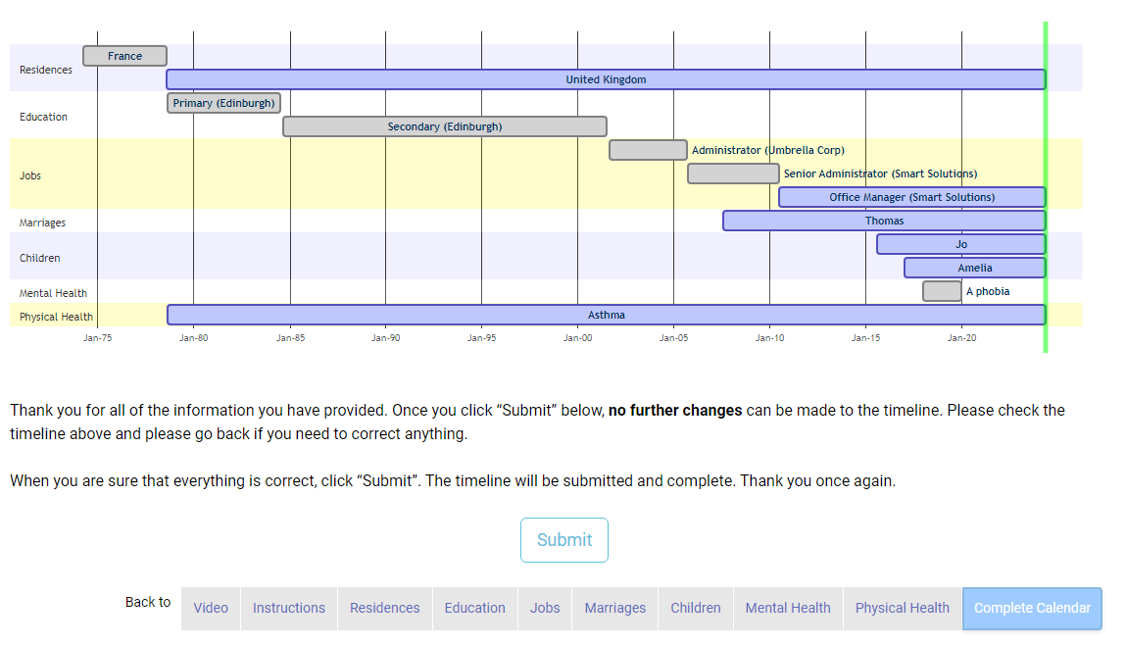
Test version: Participants able to download their version of the calendar

Slide 176
Testing on Understanding Society - 2
Further usability testing Spring/Summer 2026
Testing on IP sample (after IP19)
https://www.understandingsociety.ac.uk/participants/projects/life-history-calendar-faqs/

Slide 177
How can we persuade people to do additional tasks?

Slide 178
Conceptual Framework for additional tasks.
Ability
Necessary kit
Technical capability
Background Characteristics
Organisations Involved
Survey Design
Additional task request:
What are we asking?
How are we asking?
What are we offering?
Markers of Effort:
  Time taken
  View leaflet/diagram
  Self-reported effort
Decision Process
Less reflective
More reflective
Outcomes:
Participation
Compliance
Comprehension
Confidence in decision
Modified from Burton et al (2021)
Notes:
Going back to the conceptual framework – compared to a consent to data linkage question, the respondent has to consider a lot more when thinking about taking on additional data collection tasks. Saying Yes, will require them to do something. The something that we’re asking them to do may be annoying, take time, be difficult, or mean providing potentially sensitive information. There is a higher barrier to acceptance, which means that we need to increase the benefits – either external benefits like useful feedback, or financial incentives, or intrinsic benefits such as appealing to altruism, making the respondent feel that they are benefiting research, and they’re helping the study.
After they have agreed to take part, there is then a step where they need to be able to take part – whether this is downloading, installing, and using an app, or wearing an activity tracker, providing a blood sample… They need to be comfortable about carrying out the task. We can try to reduce obstacles here, by trying to make the experience as smooth as possible and reduce the number of steps where someone could drop out of the process. We should try to make it as easy as possible to go from agreeing to take part to providing the data. So we need to make the app easy to find and initiate, the instructions have to be clear and easy to follow, guidance should be provided where needed – for example videos, helplines, and so on.
The ability to take part affects compliance, as well as participation. Where the task is too demanding – or the costs outweigh any benefits – then respondents are likely to drop out of the survey, and provide incomplete data.

Slide 179
Participation in additional tasks depends on…
Design of baseline survey
  Survey mode (interviewer / self-completion)
  Respondent incentives (for baseline survey / for additional task)
  How the task is presented (affecting willingness)
Nature of task
  Domain/topic of data (health, wellbeing > finance)
  Duration of task (number of days / time per day)
  Technical ease – lack of friction – to carry out the task

Slide 180
Participation in additional tasks depends on… 2
Protocols for implementation of task
  Incentives (bonuses for compliance)
  Feedback (if information not known to respondents)
  Mode of invitation to task (in interview > by post)
  Placement of invitation to task in baseline survey (early > late)
  Reminders
Reviewing the points at which people may drop out and reducing the ‘friction’

Slide 181
On a final note – can we ask too much?
In a recent working paper Mitchell and Jäckle (2026) use the multiple requests in the IP
  Sample members participated in just under half of tasks they were invited to
  Controlling for selection bias, each additional task:
    Decreases the probability of participating in a task (by 4pp)
    Decreases the probability of taking part at the next wave (by 0.5pp)
We can ask people to do more, but we need to weigh up the benefits to the study with the potential risk
This is one of the values of the Innovation Panel – to test the effects of these additional task and work out how best to implement them.
https://www.understandingsociety.ac.uk/research/publications/working-paper/understanding-society/2026-01/
Notes:
Recent – earlier this month
“multiple requests” - I’ve mentioned experiments we’ve implemented on the Innovation Panel during this presentation, but there have been others.
Trappmann et al (2023) find that asking panel members to download an app to provide sensor data impacts response at the next wave (3.3pp) but bounces back after that

Slide 182
Thank you
Colleagues
  Annette Jäckle, Mick Couper, Tom Crossley, Sandra Walzenbach, Jim Vine, Michaela Benzeval, Brienna Perelli-Harris, Brendan Read, Paulo Serodio, Alexander Wenz, Daniel Horn, plus advice and help from many other colleagues
Fieldwork organisations
  Verian, NatCen Social Research, Ipsos MORI
App developers
Kantar Worldpanel, Qmob, Connect Internet Solutions, Select Research, Glitchers
Funder
  Economic and Social Research Council UK
Data
University of Essex, Institute for Social and Economic Research (2025). Understanding Society: Innovation Panel, Waves 1-17, 2008-2024. [data collection]. 14th Edition. UK Data Service. SN: 6849, DOI: http://doi.org/10.5255/UKDA-SN-6849-17

Slide 183
What about you?
Consent to data linkage
  Are you required to ask for consent?
  What other legal/ethical issues do you encounter?
Additional tasks
  What additional tasks have you asked respondents to do?
  Have you been able to test these experimentally?
  What have you found?
  What is next….?

