Slide 1


Harnessing Technology for Collecting and Analyzing Caregiving Narratives
Emily Mroz, PhD
Assistant Professor
Nell Hodgson Woodruff School of Nursing
emily.mroz@emory.edu

Slide 2

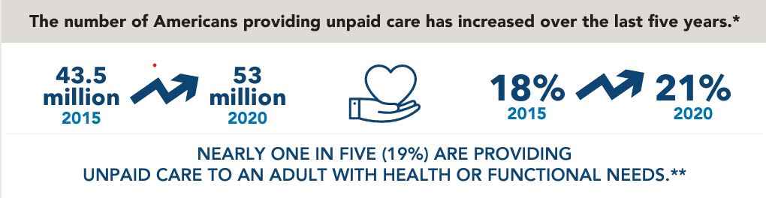
Supporting Family Caregivers is a Public Health Priority
For caregivers to those living with Alzheimer’s Disease or related dementias:
caregiving can harm caregivers’ health, wellbeing, close relationships, and quality of life
Consequences of caregiving often persist even after caregiving roles have ended.

Slide 3
Narrative Interventions May Improve Caregiver Health
Narrative therapeutic interventions are beginning to be used with dementia-caregivers
These can help caregivers reframe meaning to improve self-beliefs and behaviors, supporting caregivers’ health
Studying caregivers’ narratives can provide important foundations for intervention development.
Current methods for collecting and analyzing narrative interventions are costly, time intensive, and poorly suited for caregivers.
Mroz et al., 2024, The Gerontologist

Slide 4
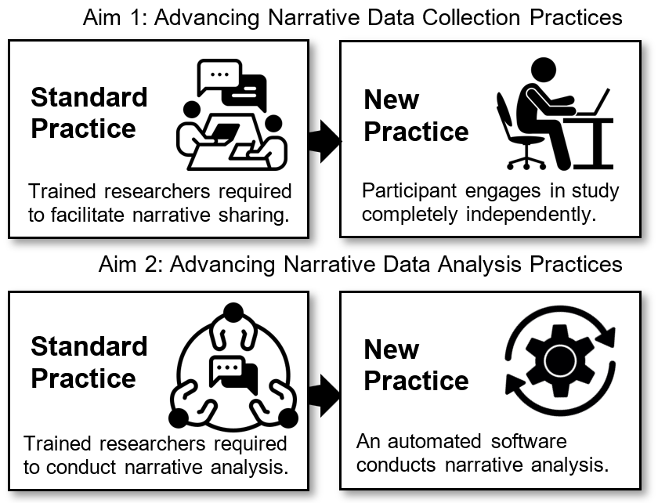
Innovative Methods for
Caregiver Narrative Research

Slide 5
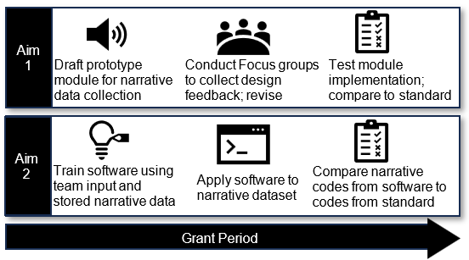

Innovative Methods for
Caregiver Narrative Research

Slide 6

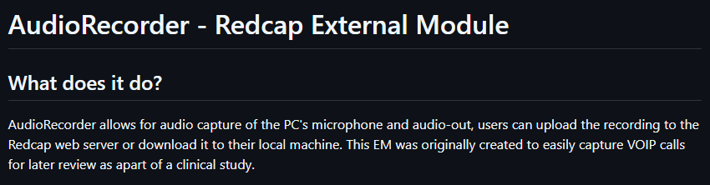
Aim 1: Narrative Data Collection Tool
Aim 1a: Draft Prototype Module for Narrative Data Collection

Slide 7
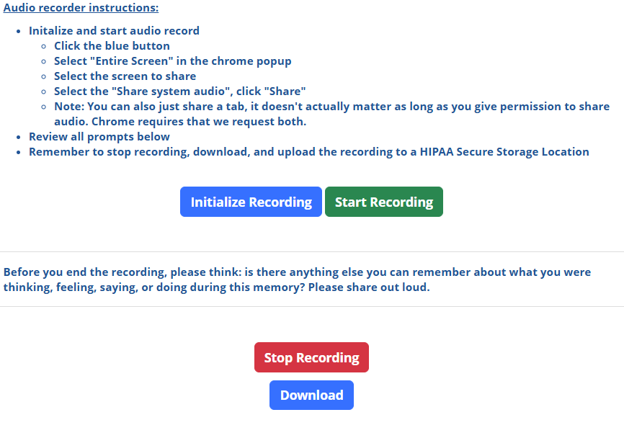



Aim 1: Narrative Data Collection Tool
Aim 1a: Draft Prototype
Module for Narrative Data
Collection

Slide 8



Aim 1: Narrative Data Collection Tool
Aim 1b: Conduct Focus Groups to Collect Design Feedback; Revise
Caregiver Focus Groups
Researcher Feedback
Participants: 13 current and former caregivers of family members and friends living with dementia
Participants: 4 researches with expertise in caregiving, user experience testing, gerontology, narrative methods
Three focus group discussions with 3-5 members per group. Audio recorder demoed during sessions.
Independent testing of audio recorder, review of synthesis from focus groups, documentation of additional insights via survey form
Transcripts analyzed using template analysis. Results focus on opportunities for improvement
Insights incorporated into final recorder revision plan

Slide 9
Aim 1: Narrative Data Collection Tool
Aim 1b: Conduct Focus Groups to Collect Design Feedback; Revise
Caregivers’ Feedback Spanned 5 Topics
User Instructions
Page Features and Layout
Recording Process
Participant Safety and Comfort
Narrative Quality

Slide 10
Aim 1: Narrative Data Collection Tool
Aim 1b: Conduct Focus Groups to Collect Design Feedback; Revise
Caregivers’ Feedback Spanned 5 Topics
User Instructions
Logical presentation of instructions
Finding the “right amount” of instructions to present on page
Addressing hesitancy to click links or pop-ups
End users’ confusion over what they should share

Slide 11
Aim 1: Narrative Data Collection Tool
Aim 1b: Conduct Focus Groups to Collect Design Feedback; Revise
Caregivers’ Feedback Spanned 5 Topics
Page Features and Layout
Page readability and use of visual cues
Retention and application of instructions through re-organization
Accessing technical support
Reviewing or playing back recording

Slide 12

Aim 1: Narrative Data Collection Tool
Aim 1b: Conduct Focus Groups to Collect Design Feedback; Revise
Caregivers’ Feedback Spanned 5 Topics
Recording Process
End user lacks an indicator to test audio input
Caregivers may need to pause during process
No indication of how long recording should be
Some researcher participants discouraged use of “pause” button

Slide 13

Aim 1: Narrative Data Collection Tool
Aim 1b: Conduct Focus Groups to Collect Design Feedback; Revise
Caregivers’ Feedback Spanned 5 Topics
Participant Safety and Comfort
End users may be skeptical that study page is a scam
Concerns about data security and recording voice online
Worry about becoming overly emotional during narrative sharing; rehearsing may help
Researcher participants encouraged recording first attempt and including emotion

Slide 14
Aim 1: Narrative Data Collection Tool
Aim 1b: Conduct Focus Groups to Collect Design Feedback; Revise
Caregivers’ Feedback Spanned 5 Topics
Narrative Quality
Participants may be fixated on recording the “perfect” narrative
Background noise may be captured during recording
May feel cold/ not personable

Slide 15
Early Takeaways
Promising Tool: caregiver and researcher participants were excited about how this could make narrative research accessible and improve participants’ experiences
Perspectives from all end users (caregiver participants, researchers) allow us to balance ideas
Most feedback is addressable through this pilot project; some feedback would require additional resources
Navigating project team management, REDCap access, and ethical oversight on tight timeline

Slide 16

Innovative Methods for
Caregiver Narrative Research
Testing two conditions: 1) standard practice with trained researcher (n = 30), 2) new practice with audio recorder module (n = 30)
Both set of participants answer:
Memory quality questionnaire
Feasibility, acceptability, and appropriateness items
Patient Evaluation of Emotional Comfort Experienced Measure

Slide 17
Innovative Methods for
Caregiver Narrative Research

Slide 18

Thank you! Kudos to the Project Team and NIMLAS

