Slide 1
Positive Activities and Well-being among Dementia Care Dyads: A Pilot Test of a Scalable Positive Activity Mhealth App
Yee To Ng, Kira Birditt, Angela Turkelson, Sung Won Choi, Noelle Carlozzi, & Lizbeth Benson
University of Michigan
Notes:
Thank you for selecting and funding our project.

Slide 2
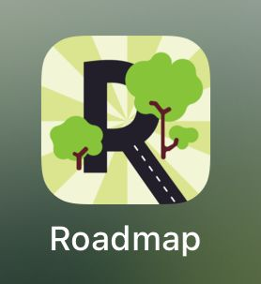
Mobile Health App: Roadmap
An app-based mHealth intervention to enhance both caregivers and patients’ well-being.
Tested with caregivers in different clinical populations (individuals with spinal cord injury, Huntington’s disease, hematopoietic stem cell transplant)
Studies support the app feasibility & benefits
Notes:
Mobile health technologies provide a lot of opportunities for data collection and intervention in caregiving settings.
Dr. Sung Won Choi from the Michigan Medicine Pediatric Department, developed a mobile app-based intervention to enhance the well-being of both caregivers and patients.
The app has been adopted by caregivers of various clinical population, eg.g individuals with spinal cord injury (SCI), Huntington’s disease (HD), and hematopoietic stem cell transplant (HCT).
Studies support the app's feasibility and benefits. Caregivers found the app highly useful and easy to use; well-being and health improved, and knowledge, skills, confidence, and engagement in managing care recipients' health increased.

Slide 3
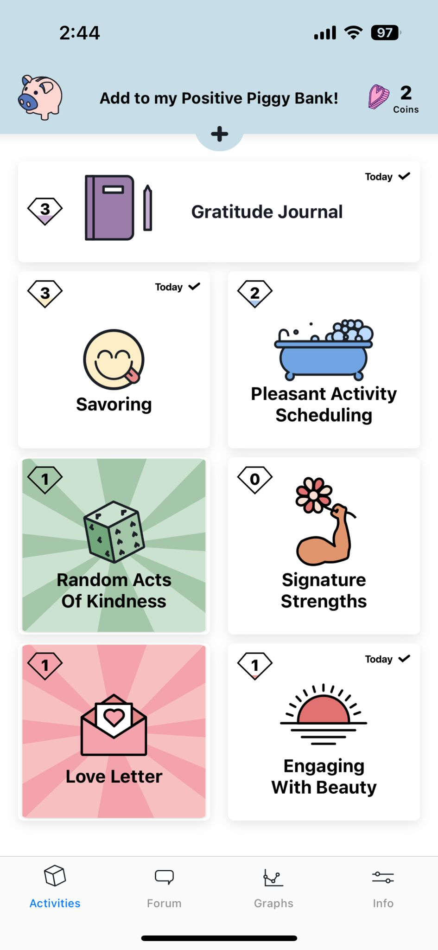
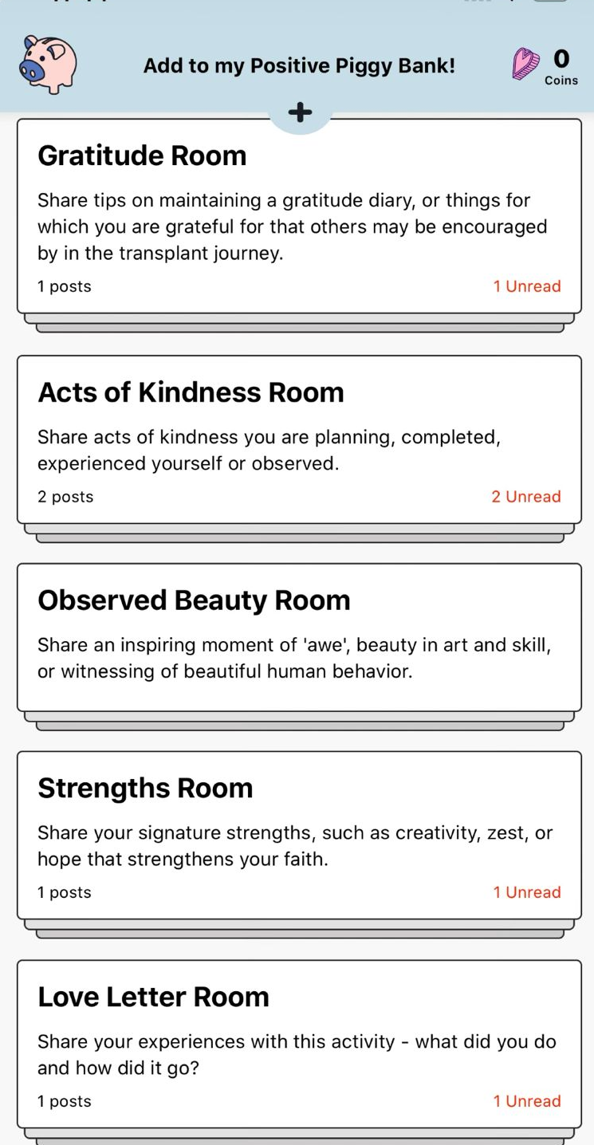
Roadmap App Positive Activities
Caregivers choose from:
Positive Piggy Bank
Gratitude Journal
Savoring
Pleasant Activity Scheduling
Random Acts of Kindness
Signature Strengths
Love Letter
Engaging with Beauty
Notes:
More specifically, the app offers a list of eight activities for caregivers to choose from, including Positive Piggy Bank Gratitude Journal Savoring Pleasant Activity Scheduling Random Acts of Kindness Signature Strengths Love Letter Engaging with Beauty. In some activities, participants are instructed to record their experiences by writing in an open-text textbox. In certain modules, they can upload a picture, encouraging them to appreciate both big and small positive moments in daily life.

Slide 4
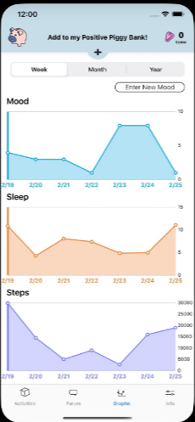
Mobile Health App: Roadmap (cont.)
The app includes a daily mood rating
The app syncs with Fitbit to display daily physical health data

Slide 5
Roadmap for Dementia Caregivers
Yet to be tested among dementia caregivers
Purpose of this pilot project is to test the roadmap app among dementia caregivers, addressing:
Aim 1: Assess positive activity engagement (via the Roadmap app)
Aim 2: Examine the feasibility and acceptability of the Roadmap app (and other study components) among dementia caregivers & study compliance
Aim 3: Adapt the Roadmap app based on participant feedback for use in larger studies of dementia caregiver well-being
Notes:
The app has not been tested among dementia caregivers but has huge potential to be specifically developed for the dementia caregiving setting.

Slide 6
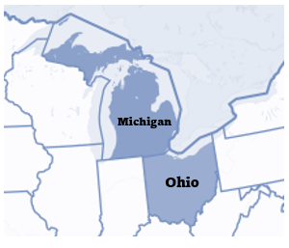

Study Design - Recruitment
Recruited a subsample 20 dyads from our existing study, Stress & Well-Being in the Everyday Lives of Caregivers (SWELCare)
Dementia caregivers (mean age = 61.15, 40% Black, 75% female, 65 % spousal caregivers) and their care recipients

Slide 7
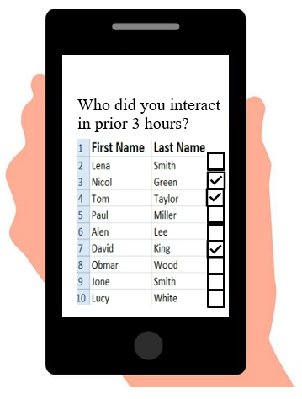
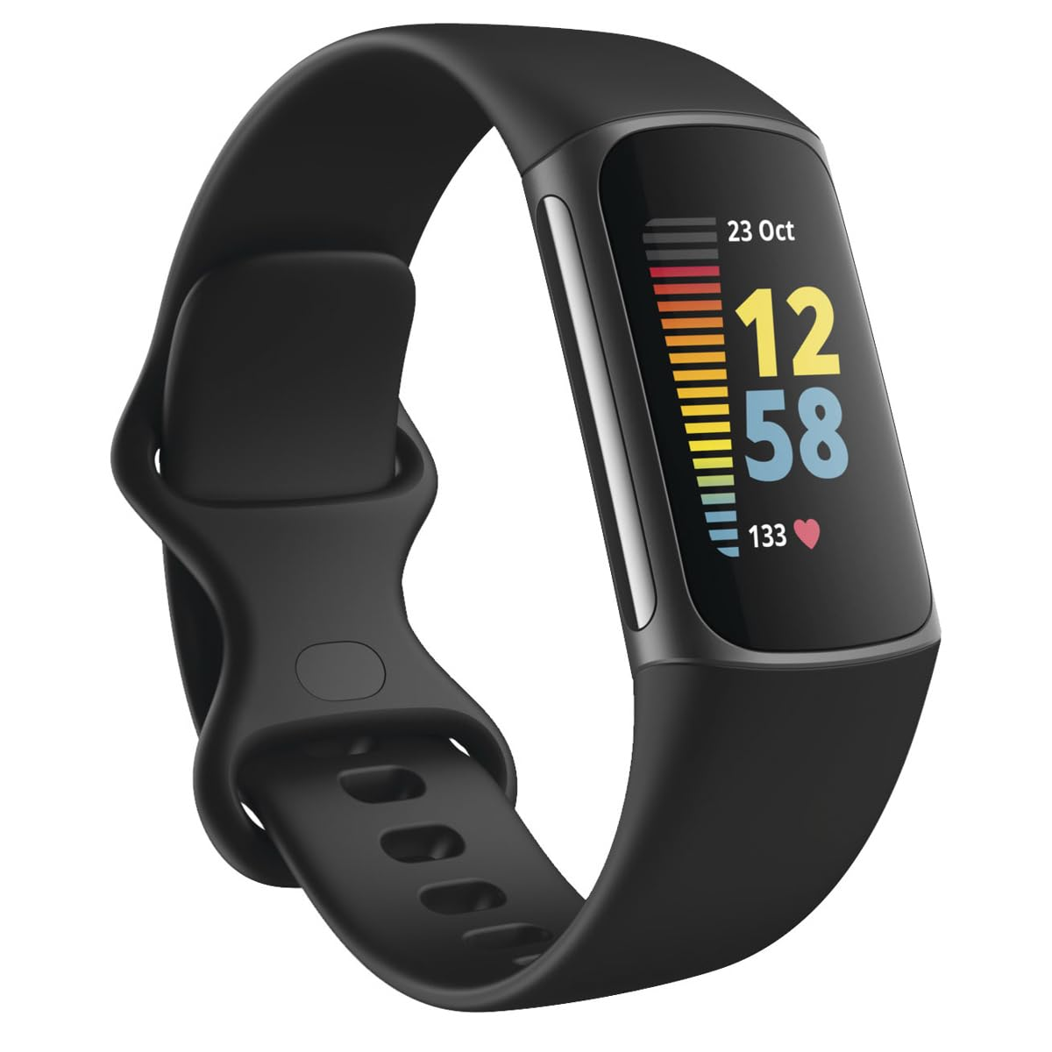
Study Design - Two Week Daily Experience Data
Roadmap app: Each day, caregivers received morning and evening prompts to engage in positive activities (can choose from 8 types)
Nightly surveys: Caregivers completed nightly mobile surveys regarding their own and care recipient well-being
Fitbit: Both caregiver and recipient wore Fitbit® Charge 5 to measure heart rate, sleep, physical activity
Notes:
Caregivers were asked to download and use the app for two weeks.
Each night, caregivers completed a mobile survey regarding their own and care recipient well-being.
During these 2 weeks, both the caregiver and care recipient wore Fitbit® Charge 5 devices to measure heart rate, sleep, and physical activity.

Slide 8
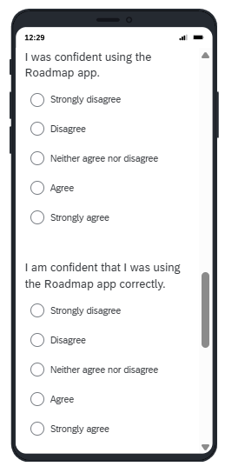
Last nightly survey
Assessed feasibility and acceptability of the
Roadmap App
Fitbit
Nightly surveys
Notes:
Using standardized and validated survey questions.

Slide 9

In-depth Interview
In-depth interviews with dementia caregivers regarding the app for improvement
Notes:
Finally, we conducted in-depth interviews with dementia caregivers regarding the app and gather feedback/suggestions for making improvement to the app.

Slide 10
Study Aims Overview: Aim 1
Aim 1: Assess positive activity engagement (via the Roadmap app)
Aim 2: Examine the feasibility and acceptability of the Roadmap app (and other study components) among dementia caregivers & study compliance
Aim 3: Adapt the Roadmap app based on participant feedback for use in larger studies of dementia caregiver well-being

Slide 11
Results- Aim 1 (1 of 2)
 | Mean | SD | Min. | Max.
# Roadmap positive activities (PAs) engaged each day | 1.66 | 0.75 | 0.83 | 3.54
% of study days engaged in Roadmap PAs | 0.87 | 0.14 | 0.58 | 1.00
Notes:
On average, caregivers completed 1.66 Roadmap-related positive activities each day (SD = 0.75) and engaged in at least one Roadmap positive activity on 87% of study days (range 58% to 100%).

Slide 12
Results- Aim 1 (2 of 2)
Positive Activity | Days N | Percent
Pleasant Activity Scheduling | 98 | 37.0%
Savoring | 70 | 26.4%
Gratitude Journal | 67 | 25.3%
Engaging with Beauty | 57 | 21.5%
Positive Piggy Bank | 48 | 18.1%
Signature Strengths | 47 | 17.7%
Random Acts of Kindness | 44 | 16.6%
Love Letters | 10 | 3.8%
Notes:
Within the Roadmap app, the top three most popular pleasant activity were scheduling, followed by savoring, gratitude journaling, engaging with beauty, the positive piggy bank, signature strengths, random acts of kindness, and love letters.
They completed over 80% of the nightly surveys

Slide 13
Study Aims Overview: Aim 2
Aim 1: Assess positive activity engagement (via the Roadmap app)
Aim 2: Examine the feasibility and acceptability of the Roadmap app (and other study components) among dementia caregivers & study compliance
Aim 3: Adapt the Roadmap app based on participant feedback for use in larger studies of dementia caregiver well-being
Notes:
Needs title

Slide 14
Results– Aim 2 (1 of 3)
Roadmap App | % (n) – Agree/Strongly Agree
Q1: The instructions for the Roadmap app setup were easy to understand. | 77.8% (14)
Q2: The Roadmap app was easy to set up. | 83.3% (15)
Q4: The Roadmap app was easy to use. | 77.8% (14)
Q5: I was confident using the Roadmap app. | 83.3% (15)
Q6: I am confident that I was using the Roadmap app correctly. | 72.2% (13)
Average scores | 78.9%
Notes:
In the last nightly survey, we asked whether the Roadmap app was easy to set up, easy to use, and whether participants felt confident using the app. Overall, across ALL these questions, 79% of participants answered “agree” or “strongly agree,” suggesting that the Roadmap app was acceptable to use.
This number may fall just below our criterion (80%), with slightly lower than expected agreement with the items such as :
The instructions for the Roadmap app setup were easy to understand,
The Roadmap app was easy to use, and
I am confident that I was using the Roadmap app correctly. The lowest agreement among these items was 72% for confidence in using the app correctly.
These items indicate that there are areas to be targeted for improvement in the instructions and in the training of participants in how to use the app.
Needs separate title names (part 1, 2, 3, etc)

Slide 15
Results– Aim 2 (2 of 3)
Fitbit® | % (n) – Agree/Strongly Agree
Q9: The instructions for the Fitbit® set up were easy to understand | 88.9% (16)
Q10: The Fitbit® was easy to set up. | 83.3% (15)
Q12: The Fitbit® was easy to use. | 88.9% (16)
Q13. The Fitbit® was comfortable to wear. | 88.9% (16)
Q14: The Fitbit® data was easy to sync with my phone. | 94.4% (17)
Q15: I was confident using the Fitbit® | 94.4% (17)
Average score | 89.8%
Notes:
Regarding the acceptability of Fitbit and nightly survey, about 90% participants reported “agree” or “strongly agree” that the Fitbit were acceptable to use , meeting our a priori specifications set at 80%.

Slide 16
Results– Aim 2 (3 of 3)
Nightly Survey | % (n) – Agree/Strongly Agree
Q17: The nightly survey questions were easy to understand. | 94.4% (17)
Q18: The nightly survey questions were easy to answer. | 94.4% (17)
Q19: Answering the nightly survey questions fit easily into my routine. | 88.9% (16)
Q20: The number of nightly survey questions to answer on the app was reasonable. | 88.9% (16)
Average scores | 91.7%
Notes:
Regarding the acceptability of nightly survey, about 92% of participants reported “agree” or “strongly agree” that the nightly survey was acceptable to use, meeting our a priori specifications set at 80%.

Slide 17
Study Aims Overview: Aim 3
Aim 1: Assess positive activity engagement (via the Roadmap app)
Aim 2: Examine the feasibility and acceptability of the Roadmap app (and other study components) among dementia caregivers & study compliance
Aim 3: Adapt the Roadmap app based on participant feedback for use in larger studies of dementia caregiver well-being
Notes:
Needs title

Slide 18
Results– Aim 3 (1 of 4)
How did you use the app? / How did you typically use the app during the study?
The majority (n = 17 out of 20) reported using the app for positive activities. Only a few participants used it for mood tracking (n = 2) or to track physical activities (n = 3).
Notes:
Two independent trained coders coded the interview questions and developed a coding scheme and identified key themes.
Needs separate title names (part 1, 2, 3, etc)

Slide 19
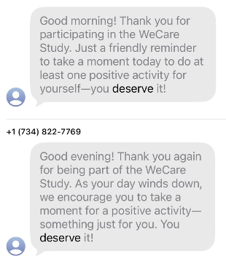
Results– Aim 3 (2 of 4)
How frequently, if at all, did you use the Roadmap app? Why or why not?
The majority (n = 16) reported using the Roadmap app at least daily, primarily due to the prompts & app features. Those who used it less than daily mentioned that the app was not relevant to their needs or busy.

Slide 20
Results– Aim 3 (3 of 4)
Is there any way we might improve the training/onboarding process of the study?
The majority (n = 15) reported that no improvement was necessary. Among those who suggested improvements, common recommendations included providing clearer explanations of the study purpose & clearer instructions for caregivers on Roadmap app.

Slide 21
Results– Aim 3 (4 of 4)
If you could add any element to the app that would be helpful to improve your experience, what would it be?
The majority (n = 15) provided suggestions, fell into two categories: Notifications/reminder changes (n=6; e.g., more encouragement messages; clearer instructions for positive activities). Add or customize activities (n=9; e.g., more individualized activities; embedding nightly survey questions into the app; allowing caregivers to monitor the patient’s Fitbit data within the app).
Notes:
The majority (n = 15) provided suggestions, which broadly fell into two categories: Notifications/reminder changes (e.g., more encouragement messages during the study period; clearer instructions for positive activities; onboarding videos for reference). Ability to add or customize activities (e.g., more individualized activities or tasks; embedding nightly survey questions into the app; allowing caregivers to monitor the PLWD’s Fitbit data within the app).
Exercise, diet

Slide 22
Summary
Dementia caregivers engaged in the app’s positive activities on more than 80% of study days, suggesting that use of the app is feasible among dementia caregivers
The Roadmap app is fairly acceptable among dementia caregivers; both quantitative and qualitative data suggest areas for targeted improvement in future studies
Served as prelim. data for a larger R01 application
Notes:
interview data showed that the majority of them engaged in the app for PA daily

Slide 23
“I would think that, over time, people become more and more aware (of the importance of engaging in positive activities)”

Slide 24
Q & A
Acknowledgement:
Fundings from Network for Innovative Methods in Longitudinal Studies of Aging (NIMLAS), R24 AG077012-01, National Institute on Aging &
Michigan Center on the Demography of Aging (MiCDA), P30 AG012846, National Institute on Aging.This research was also funded by Daily Experiences Among Black and White Dementia Caregivers: Implications for Well-being and Cardiovascular Health, R01 (AGO63200), National Institute on Aging (Birditt, PI).
Notes:
Nimilas and micda funding

